Slide 1



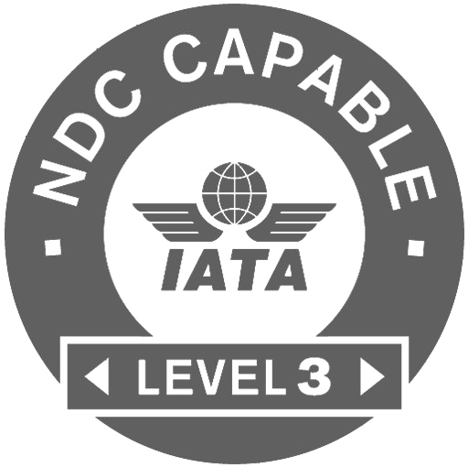
Best Practices for Agents

Slide 2



Welcome!
Atriis is your one stop shop for all travel products your travelers will need. Book flights, hotels, rail, car rentals and other products from your GDS and directly from the suppliers; manage your online and offline bookings in one system and follow up on your reservations from the trip monitor.
Below you will ﬁnd our best practices and recommendations for taking the best out of the platform and creating fast, efficient and clear workflow.

Slide 3
Atriis Available Products
Atriis is able to integrate to different GDS and Non-GDS suppliers and have the content available for search, booking and purchase directly from the source. For Non-GDS content the platform will use passive segments or direct API integration to keep the record and consistent flow with other systems in operation.
Please note, the list of products available on your Atriis Portal is based on your organization’s commercial agreements.
General Recommendations

Slide 4
Atriis Available Products
GDS
Atriis integrates to all major GDS Suppliers and offers the flight, hotel and car rental content as a standard. The availability of other products, such as NDC, rail and low-cost carriers may vary between different GDSs.
Low-cost Aggregators
TravelFusion
Ypsilon
NDC via GDS
LH Group (LH/OS/SN/LX) - Sabre
AA – American Airlines - Sabre
UA - United Airlines - Sabre
SQ - Singapore Airlines - Sabre
QF – Quantas Airlines – Sabre
AY – Finnair - Sabre
SK – Scandinavian Airlines - Sabre
TP – TAP Air Portugal - Sabre
NDC Direct
BA – British Airways NDC Direct
LH Group (LH/OS/SN/LX) NDC Direct
AA - American Airlines - NDC Direct
UA - United Airlines - NDC Direct
AF & KL – Air France & KLM - NDC Direct
IB – Iberia - NDC Direct
General Recommendations

Slide 5
Atriis Available Products
Non- GDS Hotel Suppliers
Expedia
Booking.com
RateHawk
Amadeus Hotel Plus (incl. HRS,Value Hotels, Bedsonline, Sunhotels, Teldar Travel, Restel, Hcorpo)
eHotel
Premier Inn
Travelodge
GoGlobal
Rail Suppliers
Evolvi
Benerail (incl. SNCB Europe, NS, CFF, OBB, Thalys, Eurostar, TGV (SNCF), ICE (DeutscheBahn), IC (InterCity) / NRT within Europe)
Amtrak
Other Products:
SunnyCars
Holiday Extras
Groundscope
Transferz
General Recommendations

Slide 6
Trip Deﬁnition
Trip is an end-to-end service for a speciﬁc journey of a traveler(s). Our goal is not only to sell the products traveler requested, but also foresee other needs and proactively offer the solutions using our experience and professional skills.
One trip can contain up to 5 travelers and all types of products in multiple quotes. Each trip in the system gets a unique trip number and is only used for the products for the same journey.
General Recommendations

Slide 7
Corporate Context
Atriis allows to store and display corporate account information in real time for both online and offline accounts. This means that all agents will have access to speciﬁc corporate negotiated rates for all products, supplier preferences, travel policy information, approval flows, reference ﬁelds and other corporate-related items.
The information will be displayed throughout the booking process and is available in one click before you start working on your trip.
Whichever product you are searching for, simply look for “Related account” ﬁeld and select the corporate account name from . We will do the rest!
General Recommendations

Slide 8

Booking Flow

Slide 9
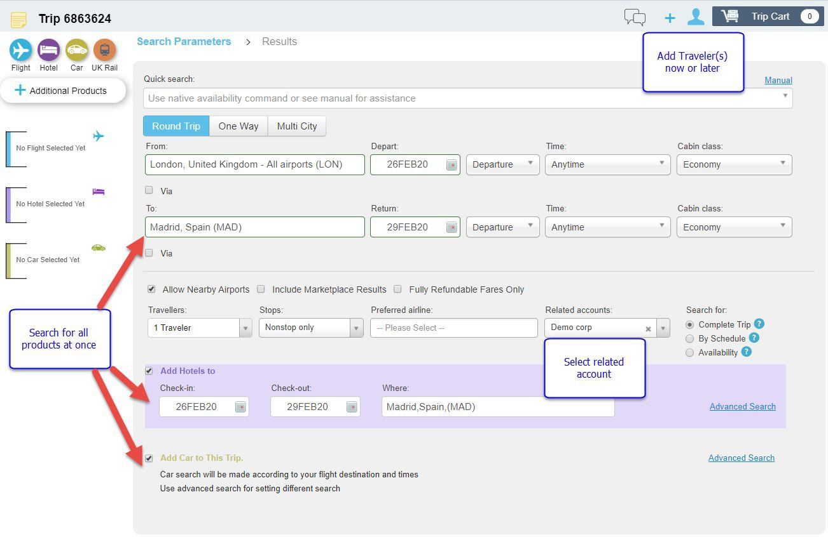
Booking a New Trip
Upon receiving a request for travel or information from the client, please start by opening a new trip on the platform. Each trip is unique and should be only used once for the same initial traveler(s).
After the travel dates of the trip pass, the trip will be locked and kept in the system for information only
Once a new trip is open, you can search for flights, hotels and cars all at once, use the corporate context or add traveler(s) to apply the relevant corporate account info.
IMPORTANT: Please note the number of travelers must be speciﬁed before the search
Booking Flow

Slide 10
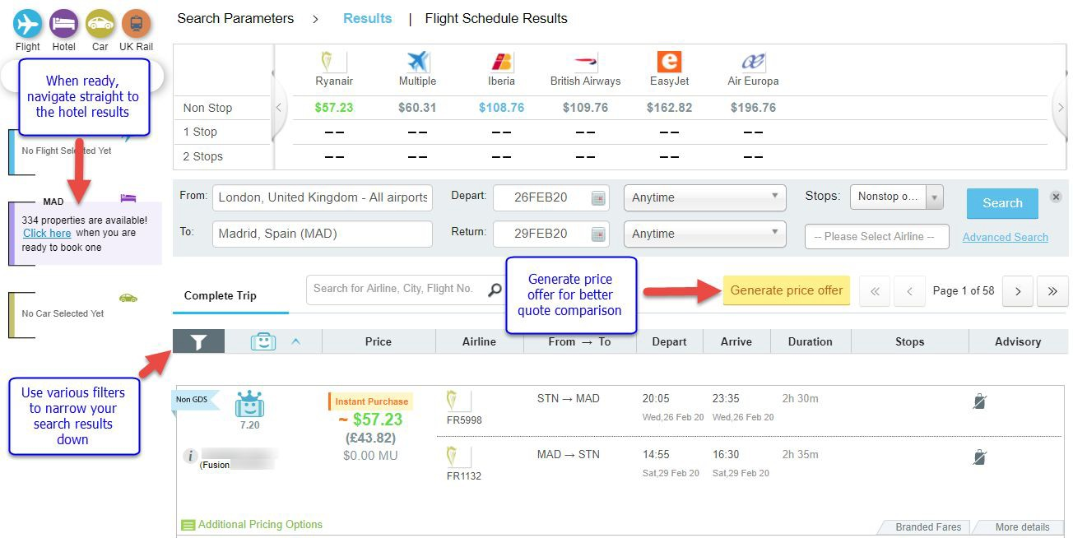
Working with the Search Results
Flight results from all available sources will be displayed after the search.
You may use different ﬁlters to narrow the list down to precise options that will suit your client’s request.
Corporate information, such as special fares, preferences and travel policy will be applied to the search if corporate account or traveler were specified.
When ready, you can navigate straight to the hotel results, without spending more time on additional searches.
Booking Flow

Slide 11
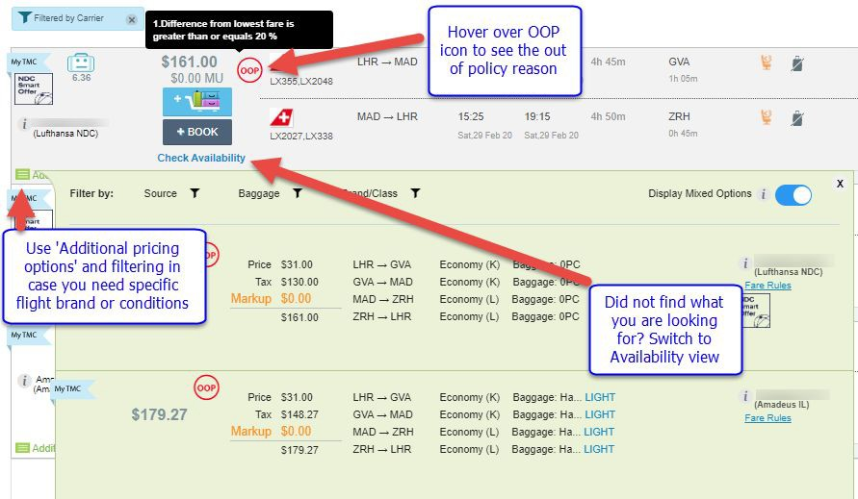
Working with the Search Results
For each flight result the platform will display the lowest fare at the main result page.
However, if a higher price or brand is required, you can always use ‘Additional pricing options’ to book it. Alternatively, ‘Check Availability’ function will display the actual flight availability where you can hand pick the booking class by yourself.
Please note, the flight result page is the main area for working with different pricing options - this will not be available at the later stage in the trip.
Booking Flow

Slide 12
Working with the Search Results
For each flight result the platform will display the lowest fare at the main result page.
However, if a higher price or brand is required, you can always use ‘Additional pricing options’ to book it. Alternatively, ‘Check Availability’ function will display the actual flight availability where you can hand pick the booking class by yourself.
Please note, the flight result page is the main area for working with different pricing options - this will not be available at the later stage in the trip.
Booking Flow

Slide 13
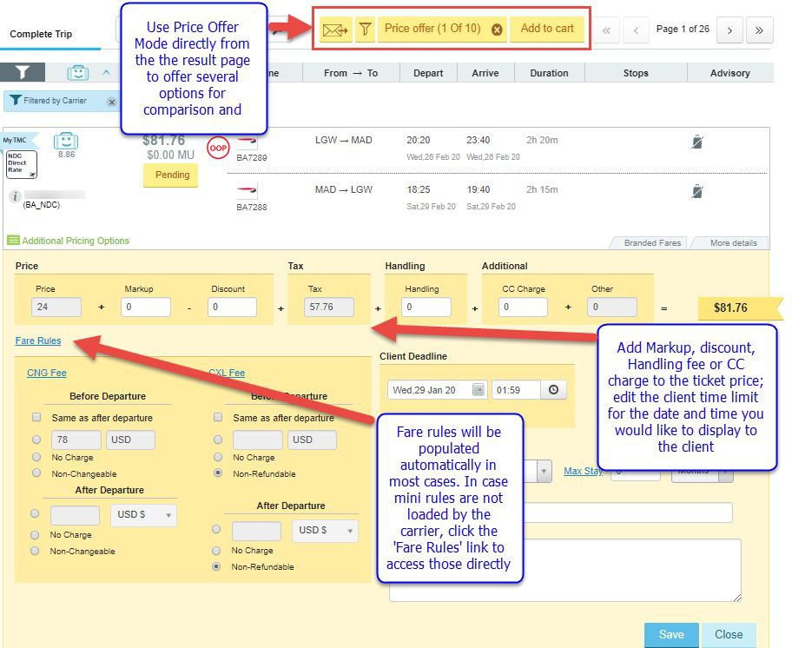
Using Price Offer Mode
‘Generate Price Offer’ button will be available on every result page for all products in distinct yellow color.
In Price Offer mode you may edit price, time limit and fare rules ﬁelds to amend the way they will be displayed to the client.
If you would like the price offer to include the entire itinerary with all products (flights, hotels, cars, rail), we recommend adding all the relevant options to the trip cart and use the price offer functionality from there.
Booking Flow

Slide 14
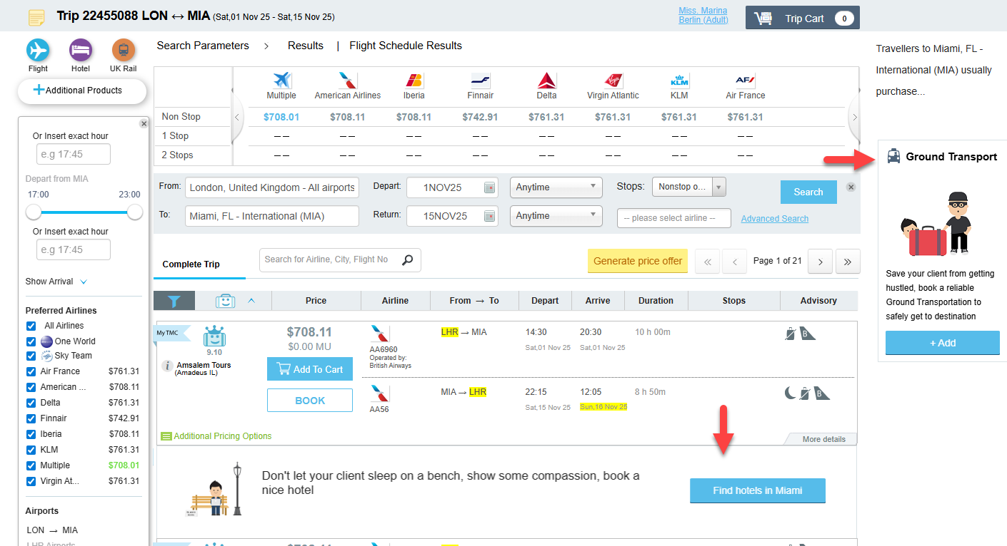
Don’t Forget Other Products!
Upsells for products that are not added to the cart yet will be offered throughout the booking process - you will be reminded that hotels, rail and ground transportation are available for immediate search and booking:
Booking Flow

Slide 15
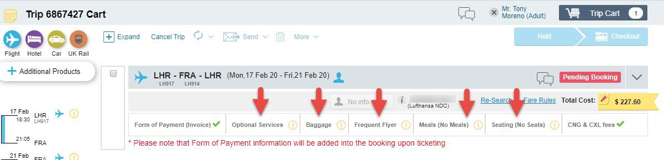
Adding Meals, Seats and Optional Services
Additional items can be added/purchased separately from the trip cart. For chargeable items the system will create EMD line and pricing in GDS. Please note the offered items might differ between different carriers and sources.
IMPORTANT: not all carriers allow separate baggage purchase. In some cases, price including baggage needs to be selected from the result page.
Booking Flow

Slide 16
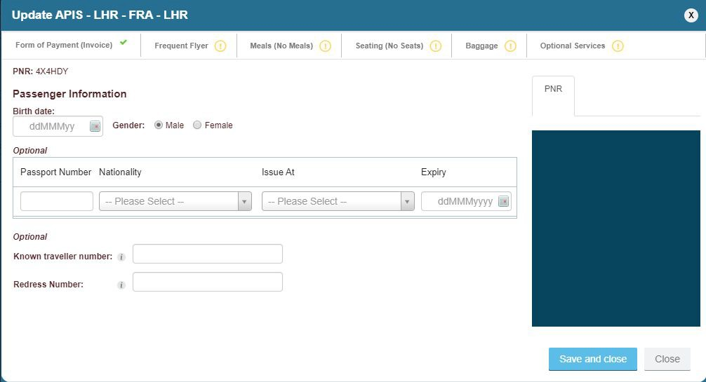
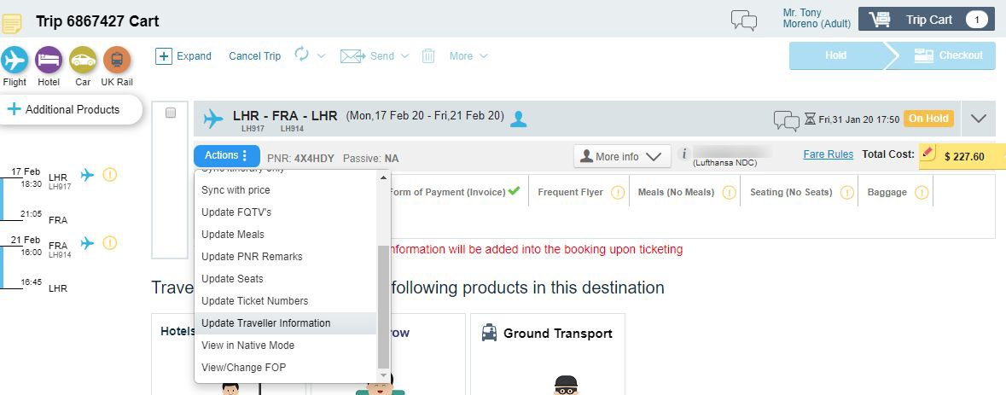

Adding APIS and FQTV Information
APIS requirements will be prompted by the platform according to the carrier requirements for a speciﬁc ticket. In case traveler’s proﬁle that contains APIS info was used, the platform will not ask for it again. If no details were present, or only partial APIS info was in a proﬁle, you will be prompted to add missing details in the trip cart:
Booking Flow

Slide 17
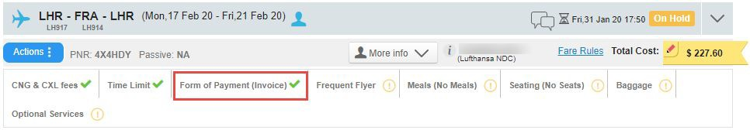
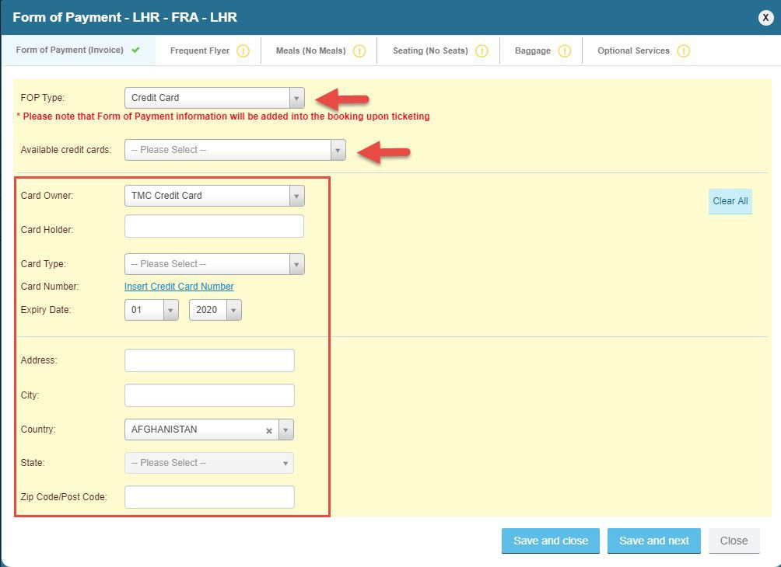
Adding/ Changing FOP
Default FOP will be applied in the trip according to your TMC and/or Corporate settings.
As an agent, you will always have the option to override and change the original FOP attributed to the trip. You can choose to use Invoice (depending on supplier) or credit card.
Pre-set TMC and Corporate credit cards will be available for selection as well as traveller’s personal cards (if present in the traveller’s profile)
Otherwise, you can add all CC details manually;
IMPORTANT: ability to change FOP is available for agents by default; for online users it is dependent on a specific permission under roles.
Booking Flow

Slide 18
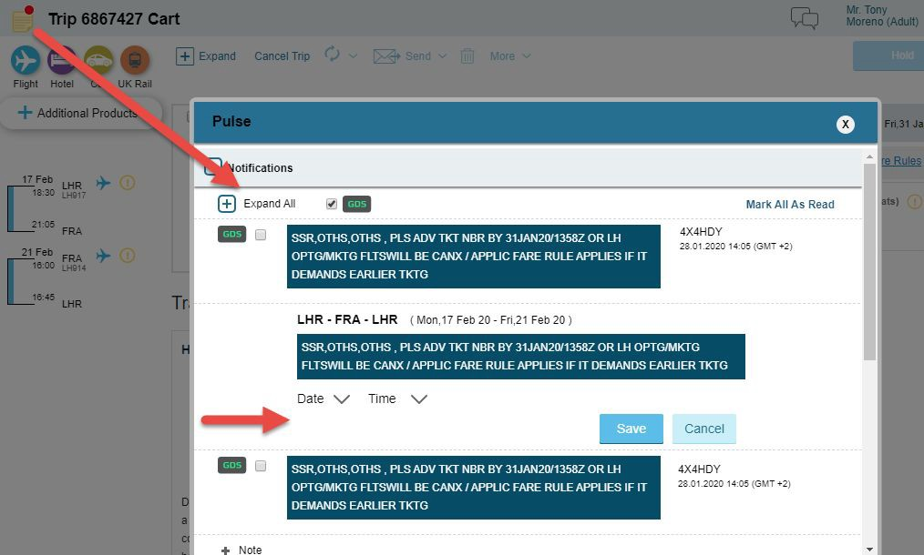
Vendor Remarks
Vendor remarks will appear under the ‘Notepad’ at the top of the left corner in the trip. You can add a reminder for yourself to pop up at certain date and time and display the remark for you
IMPORTANT: please note the system does not automatically update the client time limit based on vendor remark. This action needs to be done manually.
Booking Flow

Slide 19
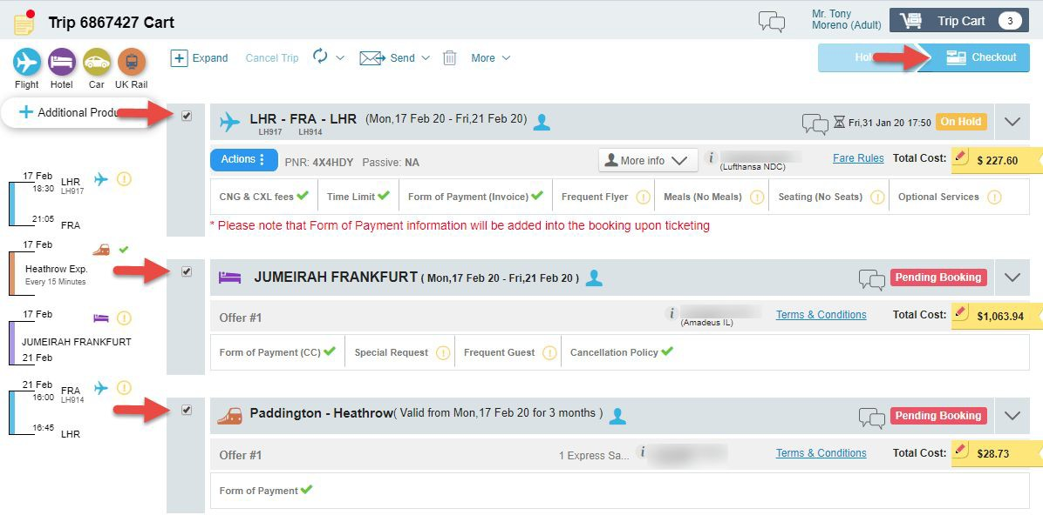
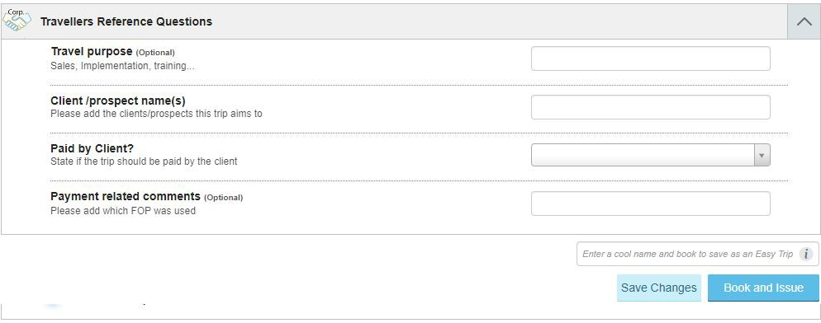
Ticketing and Invoicing
When ready to purchase your products, select the quotes and head to the checkout.
Checkout process will include all corporate and TMC reference ﬁelds and approval flow (if applied).
In addition, all relevant PNR remarks will be added to the PNR prior to ticketing.
IMPORTANT: all non-GDS content will be issued automatically;
GDS tickets will be issued according to your TMC settings.
Booking Flow

Slide 20
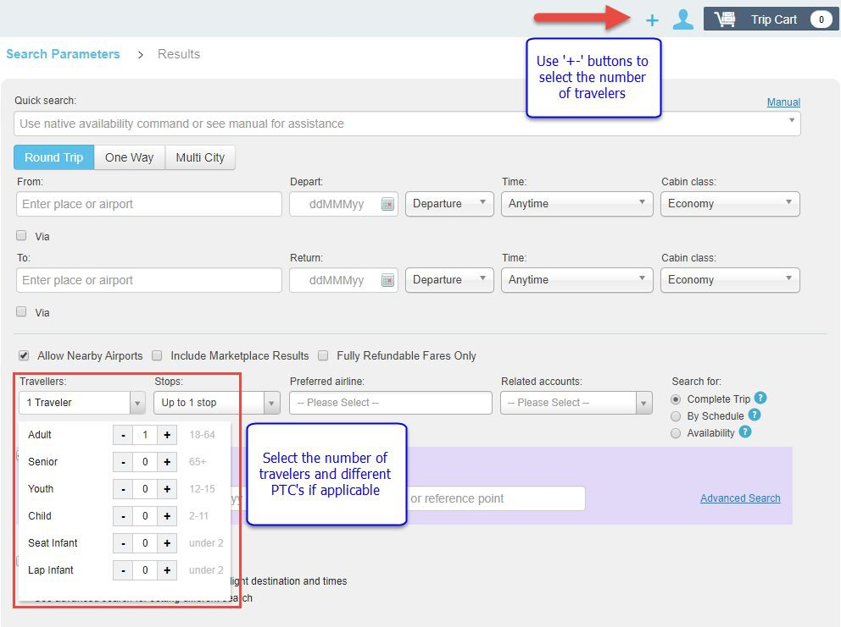
Booking for Multiple Travellers?
In general, the platform supports bookings for up to 5 travelers in the trip. You can select the number of travelers and add their details using the proﬁle icon at the top of your trip or ‘Travelers’ ﬁeld at the bottom.
However, for corporate travelers we recommend to use one trip per traveler to allow separate FOP, invoicing and possible flexibility for changes in future.
In case several travelers have the same arrangements, you can use ‘Copy Trip’ functionality to make the process faster.
Booking Flow

Slide 21
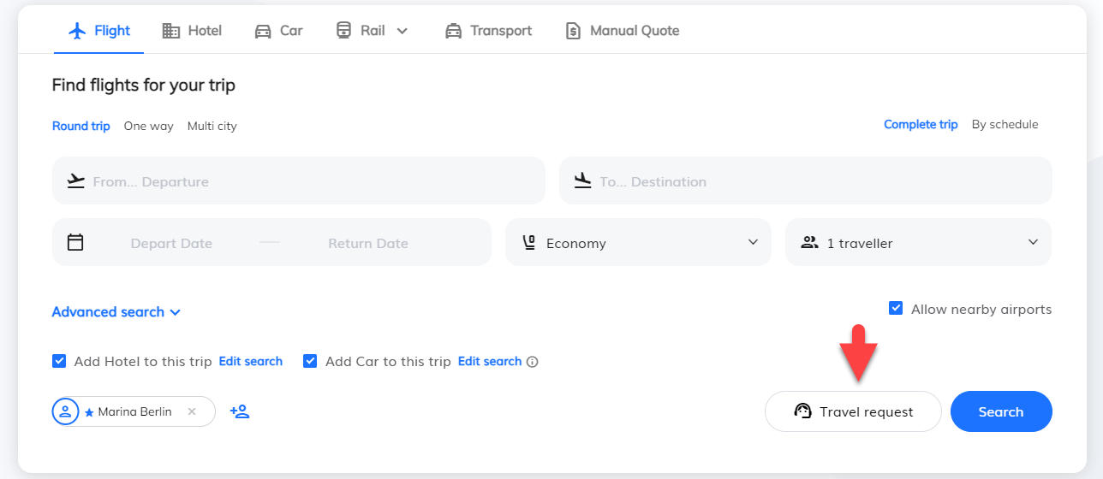
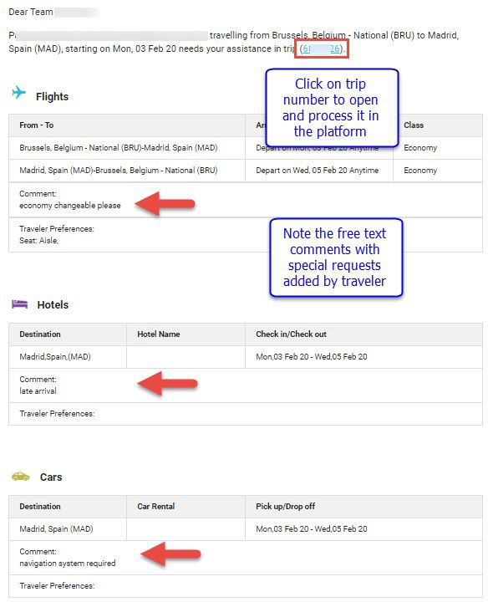
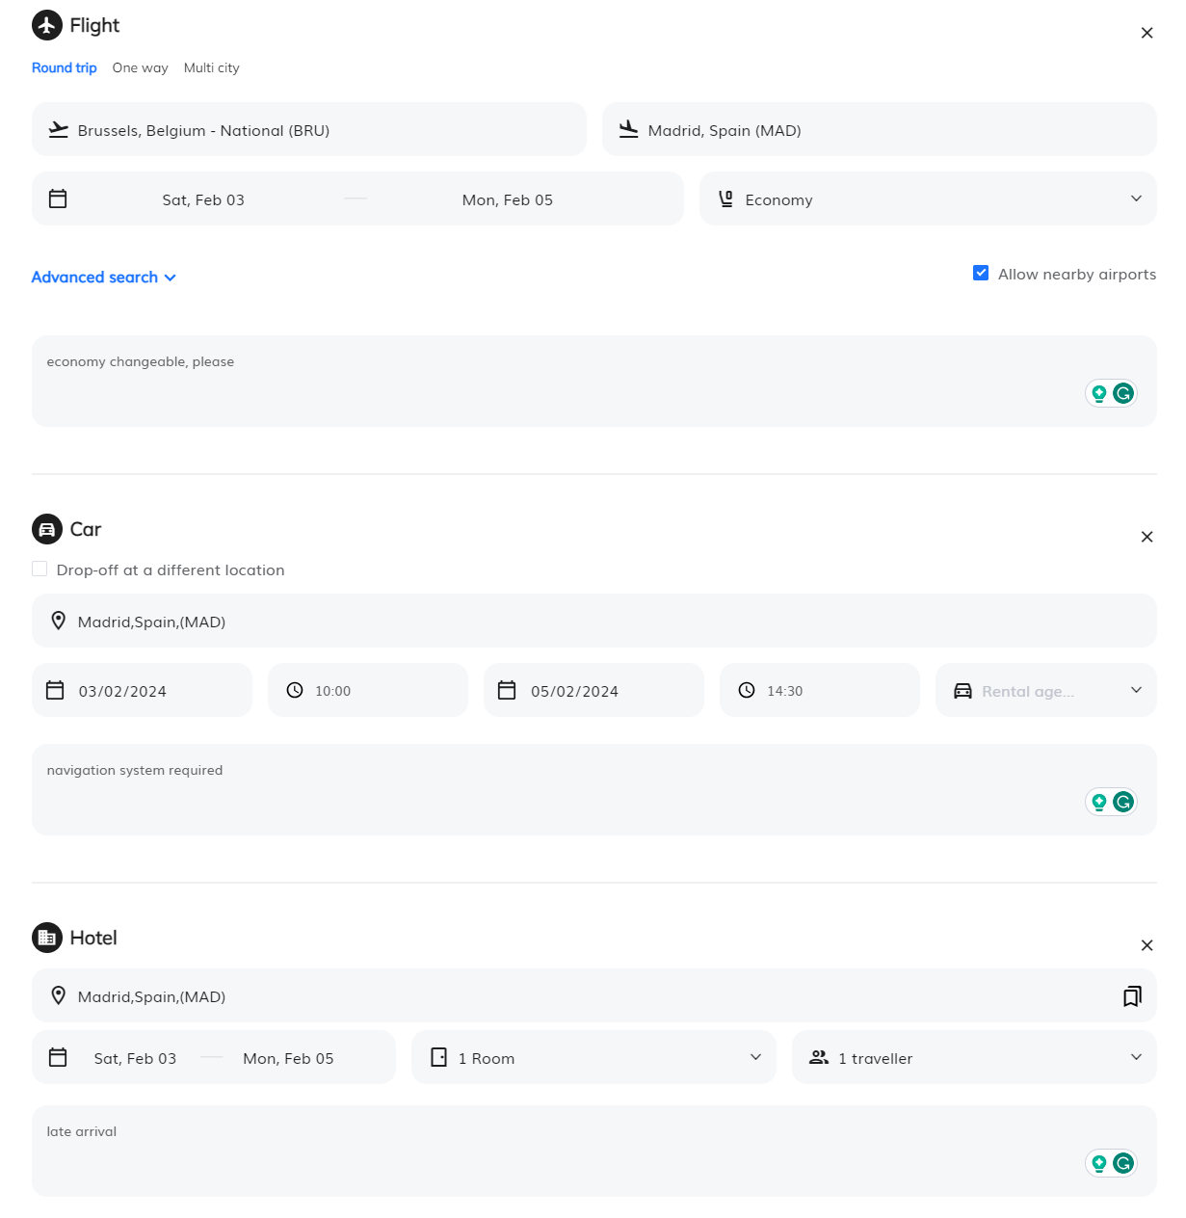
Why Online Travel Request is a Great Feature for an Agent?
Does your Corporate account have
online access, but prefers to request Traveler’s view: the agent to do the work?
Agent’s view:
Encourage your client to ﬁll the ‘Travel Request’ form and it will make the handling process much more efficient for yourself;
Process the online request either from the platform or open the trip directly from your inbox and simply click ‘Search Online’. The platform will consider all corporate settings and client’s preferences. The only thing you will need to pay attention to, will be the free text comments coming from traveler.
Booking Flow

Slide 22

Post-sale services

Slide 23
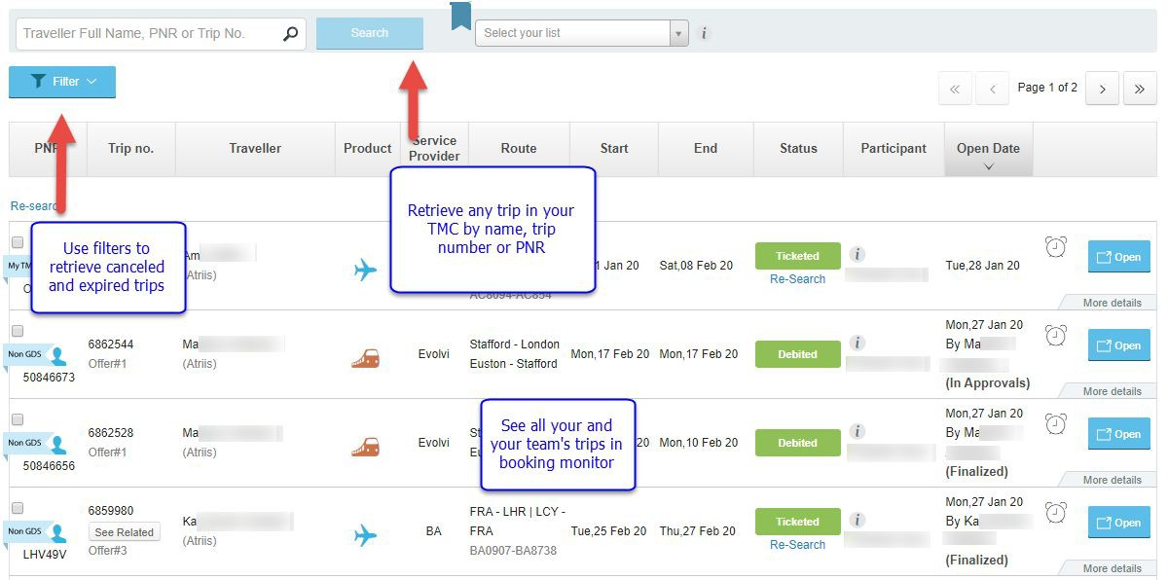
Retrieving an Existing Trip
Your and your team’s trips will always be available and visible on trip monitor;
You can search for any trip in your TMC by using a search ﬁeld at the top of the screen;
Cancelled and expired trips will be hidden from the booking monitor, but we will keep them in the system. When searching for a cancelled trip, all you need to do is open the ﬁlters and tick the checkbox to show cancelled and expired quotes.
Post-sale services

Slide 24
Which Changes can be Performed on Flight Bookings?
 | Amadeus Edifact | Sabre Edifact | Travelport Edifact | Amadeus NDC | Sabre NDC | Travelport NDC | BA NDC | LH NDC | UA NDC | AA NDC | AF/KL NDC | IB NDC | Travel Fusion
Changes for PNR on hold | ✅ | ✅ | ✅ | ✅ | ✅ | TBU | ✅ | ✅ | ✅ | ✅ | ✅ | ✅ | ❌*
Standard exchange for ticketed PNR, upgrade to a higher booking class | ✅ | ✅ | ❌ | ✅ | ✅ | TBU | ✅ | ✅ | ✅ | ✅ | ✅ | ✅ | ❌*
Exchange after departure | ✅ | ✅ | ❌ | ✅ | ✅ | TBU | ✅ | ✅ | ✅ | ❌ | ✅ | ❌ | ❌*
*The functionality is not supported by the supplier
Post-sale services

Slide 25
Which Changes can be Performed on Flight Bookings?
 | Amadeus Edifact | Sabre Edifact | Travelport Edifact | Amadeus NDC | Sabre NDC | Travelport NDC | BA NDC | LH NDC | UA NDC | AA NDC | AF/KL NDC | IB NDC | Travel Fusion
More than one exchange | ✅ | ✅ | ❌ | ✅ | ✅ | TBU | ✅ Up to 3 per ticket | ✅ Up to 3 per ticket | ❌ | ✅ | ✅ | ✅ | ❌*
Change the route for ticketed PNR | ✅ | ✅ | ❌ | ✅ | ✅ | TBU | ✅ | ✅ | ✅ | ❌ | ✅ | ❌ | ❌*
Multi-traveler/ Multi PTC/ Multi-segment | ✅ | ❌ 1 traveller per trip | ❌ | ✅ | ✅ All except multi PTC | TBU | ❌ | ✅ PNR needs to be split first | ✅ | ✅ | ❌ | ✅ | ❌*
*The functionality is not supported by the supplier
Post-sale services

Slide 26
How to Handle PNR Split?
Split PNR action is only supported for LH Group Direct NDC and BA Direct NDC.
When the handling requires splitting the PNR for any GDS booking, please follow the below steps:
Split the PNR in GDS
Import the new PNR into the new trip in the platform
Sync the original trip to update its information
For LH NDC and BA NDC PNRs this action will be available in the trip cart in case there is one ticket issued per traveler and the PNR does not contain other products or suppliers.
IMPORTANT: our general recommendation is to use one trip per traveler for the corporate travelers. This is to ensure that each traveler gets the option to use separate FOP, travel policies, approval flow and the flexibility to change the ticket when needed.
Post-sale services

Slide 27
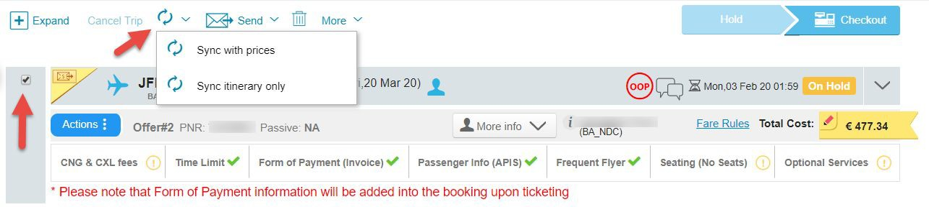
Sync Trip with Booking Source
The platform will sync all the information from GDS every 15 minutes automatically (dependent on the admin settings).
In case a change has been performed and you would like to see in the trip immediately (for sharing the itinerary with the traveler for example), please use one of the following options in the trip cart:
Sync itinerary only - will retrieve and update the segment information
Sync with price - will retrieve and update segment and pricing information
Post-sale services

Slide 28
Post-Sale Capabilities
 | Amadeus Edifact | Sabre Edifact | Travelport Edifact | Amadeus NDC | Sabre NDC | Travelport NDC | BA NDC | LH NDC | UA NDC | AA NDC | AF/KL NDC | IB NDC | Travel Fusion
PNR (segment) cancellation for full booking | ✅ | ✅ | ✅ | ✅ | ✅ | TBU | ✅ | ✅ | ✅ | ✅ | ✅ | ✅ | ❌*
Partial PNR cancellation | For PNR on hold: - cancel the entire quote and search again with updated search criteria - use the “change” option to re-search and select different segments in the same PNR For ticketed PNR: Use the exchange functionality |  |  |  |  |  |  |  |  |  |  |  | ❌*
Ticket Void | ✅ | ✅ | ❌ To be performed directly on GDS and synced back to Atriis trip | ✅ | ✅ | TBU | ✅ 24 hours after booking | ✅ Auto voided with PNR cancellation before midnight on the day of ticketing |  |  |  |  | ❌*
*The functionality is not supported by the supplier
Post-sale services

Slide 29
Post-Sale Capabilities
 | Amadeus Edifact | Sabre Edifact | Travelport Edifact | Amadeus NDC | Sabre NDC | Travelport NDC | BA NDC | LH NDC | UA NDC | AA NDC | AF/KL NDC | IB NDC | Travel Fusion
Refund for unused ticket | ❌** | ❌** | ❌** | ✅ | ✅ | TBU | ✅ Cancelling the quote will automatically refund cancelled ticket that is not eligible for void |  |  |  |  |  | ❌*
Refund for partially used ticket | ❌** | ❌** | ❌** | ✅ | ✅ | TBU | ❌ | ❌ | ✅ | ❌ | ✅ | ✅ | ❌*
Refund after exchange | ❌** | ❌** | ❌** | ✅ | ❌ | TBU | ❌ | ✅ | ✅ | ✅ | ✅ | ✅ | ❌*
*The functionality is not supported by the supplier
**Segments will be cancelled, but refund needs to be processed on the original system
Post-sale services

Slide 30
Changes for Other Products
Hotels
Existing Hotel bookings can be amended to change the travel dates. The process of changing the hotel quote involves cancelling the current quote and re-booking the new dates. Please be mindful of the refundability and the original quote cancellation rules before proceeding.
Exceptions: Imported PNR, Premier Inn, Travelodge, Booking.com, RateHawk, eHotel. To make a change for these suppliers’ booking, please cancel the original quote and book a new one.
In addition, changes are not supported for multi-traveller bookings.
Car, Rail & Ground Transportation
Car rentals booked on GDS can be changed directly on GDS and synced back to the Atriis trip
All Non-GDS suppliers (Non-GDS car rentals, Rail and Ground Transport) do not support changes to their bookings. In case a change is required, please cancel an existing quote and search for a new one with new search parameters
Post-sale services

Slide 31

Flight Booking Best Practices

Slide 32
Flight Search Methods for Best Results
Complete Trip | Search by Schedule | Availability
Method: Searching for all city pairs including ﬁnal price (master pricer); | Method: Searching for each city pair individually based on one-way fares, with ﬁnal pricing at the end of process | Method: Searching for and displaying availability in GDS format
When to use: + Long Haul + Round trip/Multi City + Unfamiliar routes Advantages: + Best price & availability overview + Lowest fares compared and displayed clearly for entire route + No extensive experience required to use + Ready for Price Offer + Ready to book immediately Drawbacks: Less results in general (each supplier limits the number of results) Less possible combinations between suppliers, brands, cabins and flight hours Unavailable flights/booking classes are not represented | When to use: + Short Haul + Domestic + Busy Routes + Mixed sources (low-cost, legacy, NDC) + Mixed cabins Advantages: + More options as searches are performed per city pair + Ability to hand pick the perfect combination + Ability to combine segments from different sources (GDS, LCC, NDC) + Ability to combine different cabin classes for each city pair Drawbacks: The ﬁnal pricing is done only at the end of the process No full picture of all options offered for full route More steps to follow Unavailable flights/booking classes are not represented | When to use: + Complex itinerary + Multi city with more than 5 city pairs + Need to offer a variety of options for some/all city pairs + Need to offer speciﬁc booking classes Advantages: + Familiar view + Flexibility in pricing + Add segments as you go + Unavailable flights/booking classes are represented + Ability to work with complex itineraries where pricing and number of tickets might vary depending on carriers and destinations Drawbacks: The ﬁnal pricing is done only at the end of the process Some sources do not support availability view and will be missing from the results No full picture of all options offered for full route More steps to follow Requires knowledge and experience from the user

Slide 33
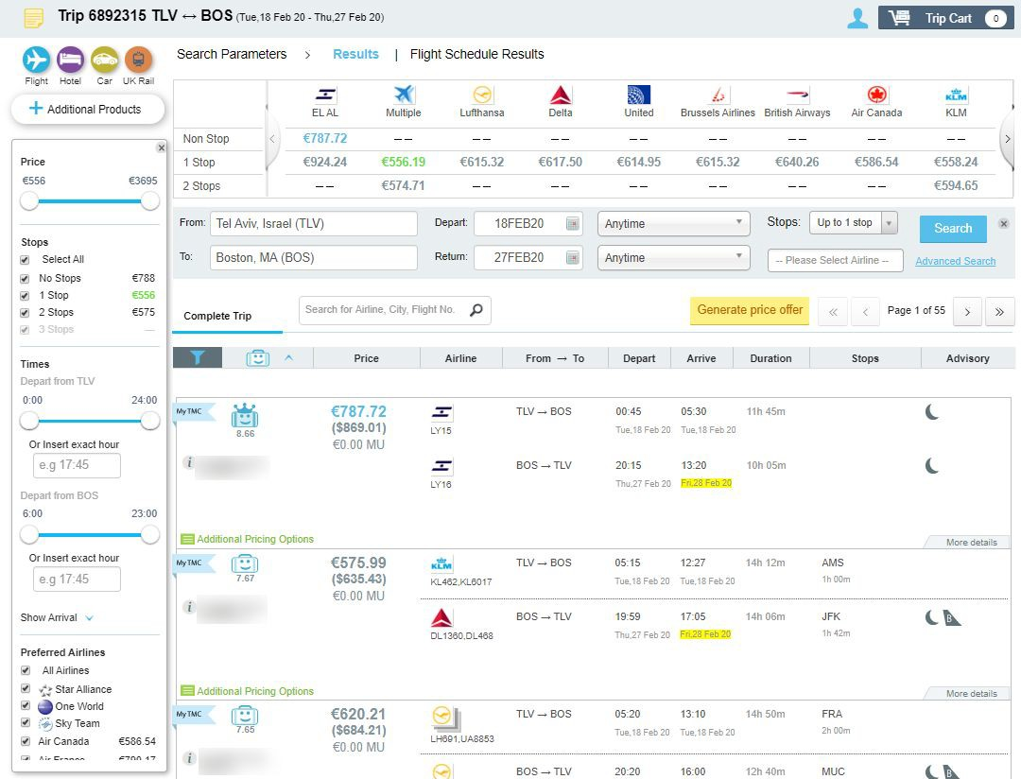
Working with Flight Results
When working on the platform, please make sure that you select the requested pricing and ticket conditions from the results.
The platform is designed to display:
Various flight content – from GDS to NDC through GDS, NDC Direct and Lowcost flights
Negotiated and special rates from TMC and Corporate settings
Different flight brands according to carrier branding
Clear indication of baggage allowance on each result
The variety of offers and combinations from different sources and suppliers
IMPORTANT: due to slight differences in functionality and flow, please note the source of the result before booking
Flights

Slide 34
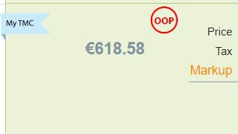
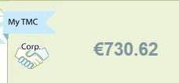
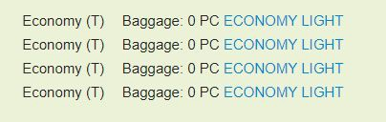
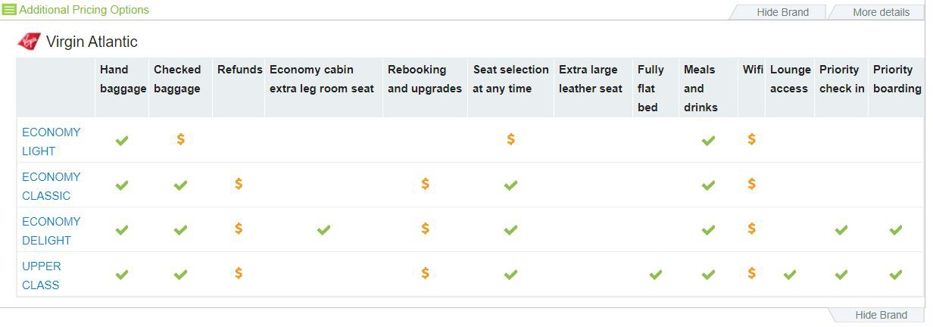
Corporate Features
Corporate information is loaded to the platform for both online and offline accounts. How does it affect flight booking flow?
Corporate negotiated fares will be displayed
Travel Policy rules will be applied and displayed in results, Trip cart and checkout process
Corporate preferences in terms of Price/Duration/ Preferred Carriers will be considered and displayed
Carriers, blacklisted by the corporate will be hidden from the results
Corporate FOP will be applied to the the PNR automatically and may differ between the suppliers
Corporate reference ﬁelds will be requested during different trip stages
Approval flows will apply according to the Corporate settings
Flights

Slide 35
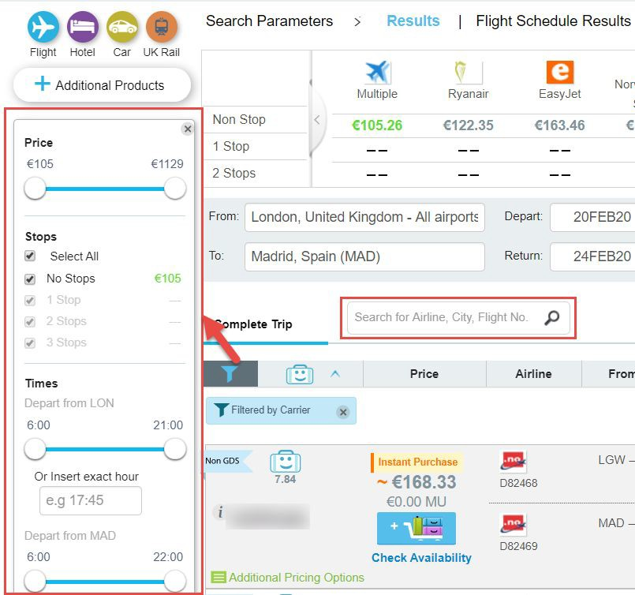
Filtering and Sorting
Advanced ﬁltering options will be offered for flight results to allow narrowing the list down to the precise results that match your criteria:
Select multiple speciﬁc carriers, custom time range, duration and price range
Need to search for speciﬁc flight numbers? Use a free text ﬁlter to input the information and we’ll do the rest
Remove any previously applied ﬁlter by clicking on ‘x’ on the blue ﬁlter label at the top of results
Done with the filter pane?
Minimize/maximize it by clicking on the funnel icon
Flights

Slide 36

Hotel Booking Best Practices

Slide 37
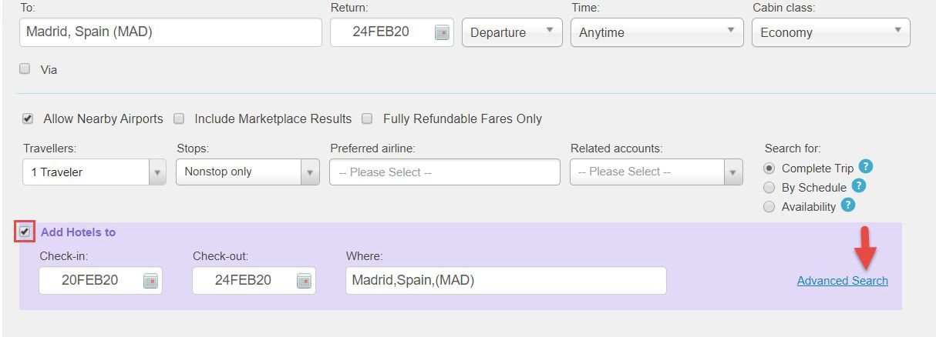
Hotel Parallel Search
Hotel search can be performed in parallel with flights and the results will be ready before you ﬁnish discussing the seat map with your client! Simply tick the checkbox below the flight search ﬁelds and the system will automatically ﬁll the dates and destination according to the flight parameters:
Hotels

Slide 38
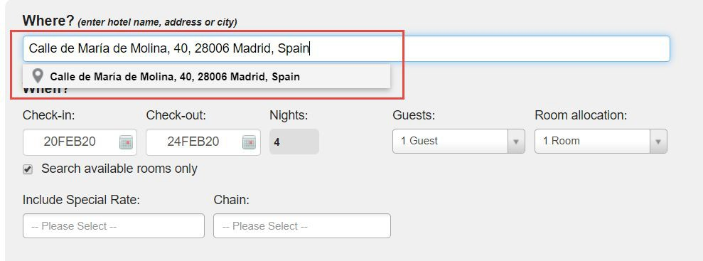
Hotel Parallel Search
Need to adjust the search criteria for the hotel? Use advanced search mode and search around a speciﬁc address, change the dates or apply chain preference.
*IMPORTANT: room allocation will automatically be 1 room per traveler. If there are 2 travelers in the trip you will be able to select double room as an option. More advanced rooming list options are not currently supported.
Hotels

Slide 39
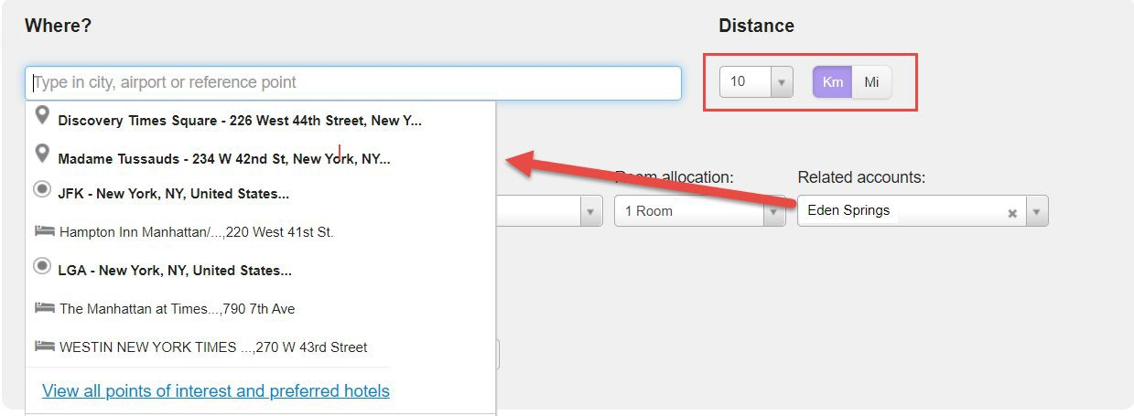
Hotel Search by Landmark, Address or POI
When a Corporate Account is selected before the search, Atriis will offer a list of saved frequently visited locations (Points of Interest) for this account and preferred hotels, linked to these locations.
Distance can be adjusted to only show the results in close proximity of the reference point.
TIP: you can search for hotels by a speciﬁc name, address or around an official landmark.
Hotels

Slide 40
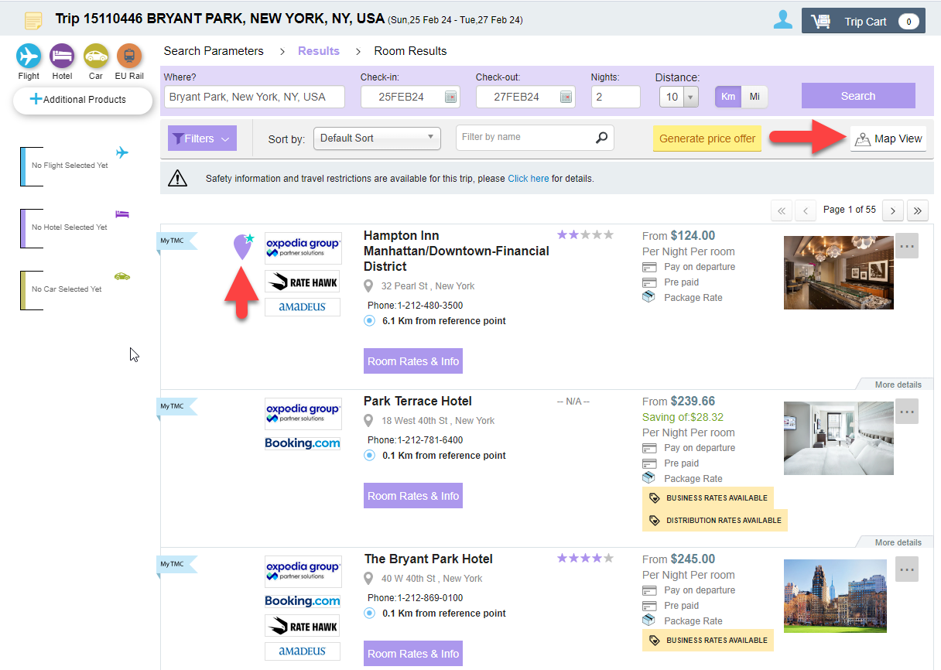
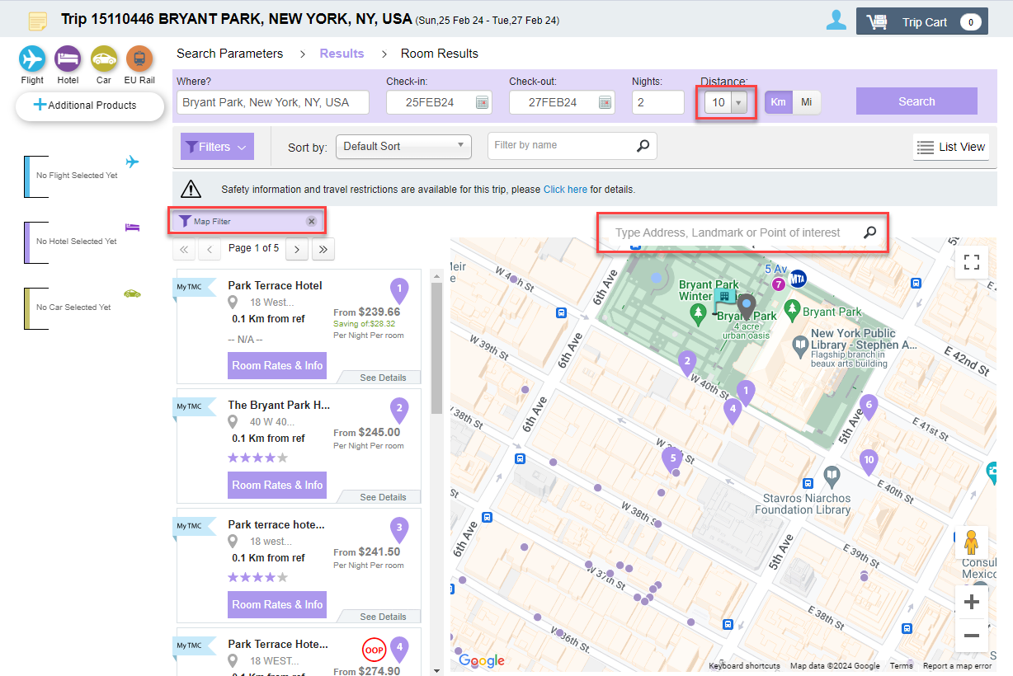
Hotel Result Display Modes
Google Maps are integrated directly into the platform, which means you can:
Switch to the map mode to display the results on map
Search the map for a speciﬁc address and see all the hotels nearby
Display corporate Points of Interest on the map and see the available hotels nearby
See the preferred hotels at their location
Hotels

Slide 41
Hotel Result Display Order
For every hotel search, the list of available properties will always be sorted according to the following default order:
- Corporate preferred properties
- Results with corporate agreement rates
- TMC recommended properties
- TMC recommended chains
- Results with TMC agreement rates
Hotels

Slide 42

Car Rental and Ground Transportation Best Practices

Slide 43
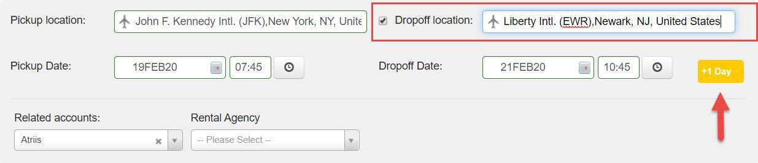
Car Rental: Parallel Search
After the flight selection, Atriis will automatically apply the flight information as car search parameters. If the drop off time is later than pick up time, it will indicate that additional day of rental will be charged. Dropoff at different location is available by ticking a checkbox and selecting the drop off point.
Any of the automatically populated details can be changed before the search if needed.
Car rental

Slide 44
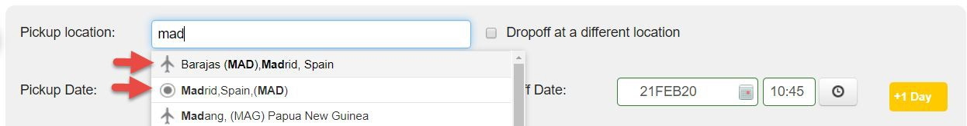
Airport and Non-Airport Search
Searches for non-airport locations are available - please see below the example of the airport and non-airport labels at the location suggestions dropdown.
IMPORTANT: Please note the car delivery option is not available through Atriis and non-airport locations only include the official vendors’ stations.
Car rental

Slide 45
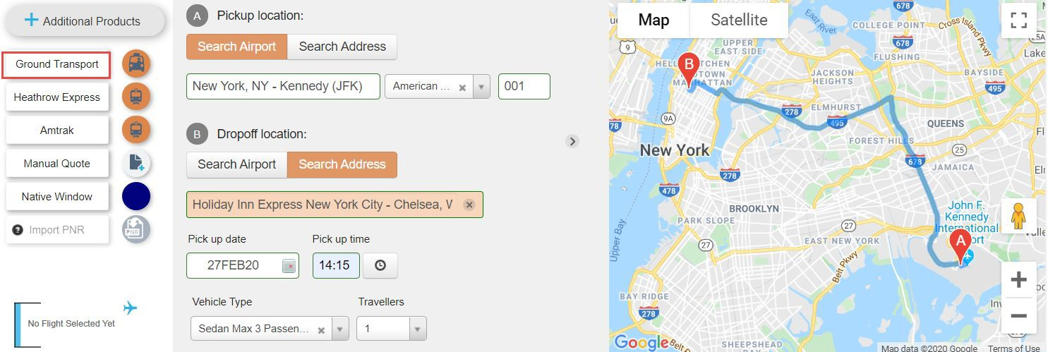
Groundscope | Transferz
If you need to offer a pre-arranged ground transfer, Atriis offers you two global suppliers that can accommodate your travelers. Please make sure the locations for pickup and dropoff contain all the required information to get results. Groundscope and Transferz are aggregators who work with local transfer companies all over the world and offer flexible booking terms.
TIP: Ground Transportation can be booked also as a standalone product
Other Products

Slide 46

Rail Booking Best Practices

Slide 47
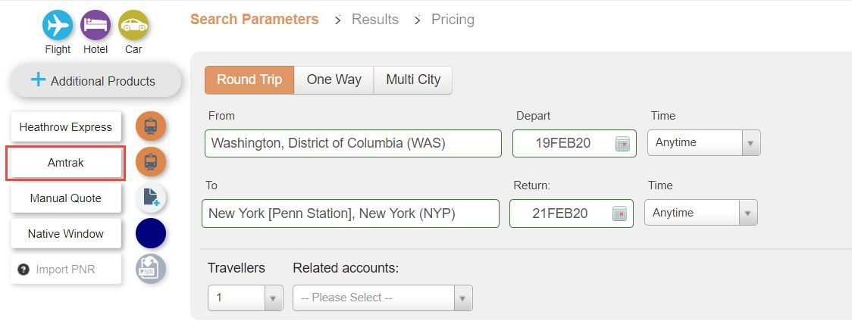
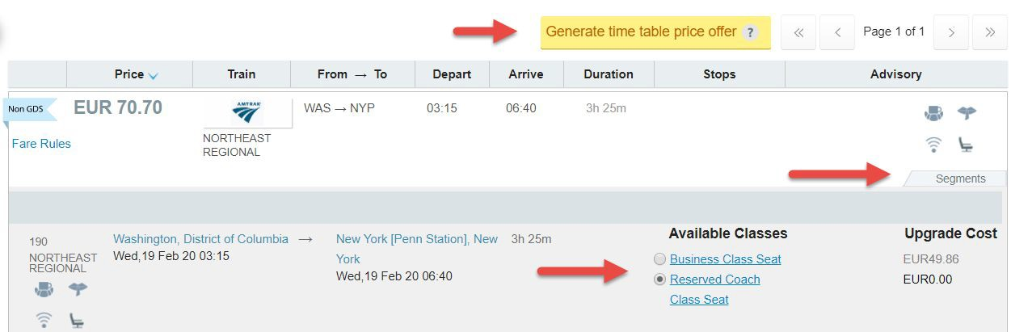
Amtrak
Any travelers in United States? Amtrak rail option is always available for you.
Search, send price offer, and purchase the ticket for your client directly from the platform
Amtrak integration is facilitated by Sabre. If you are using a different GDS, a passive segment will be created in your GDS by Atriis.
Other Products

Slide 48
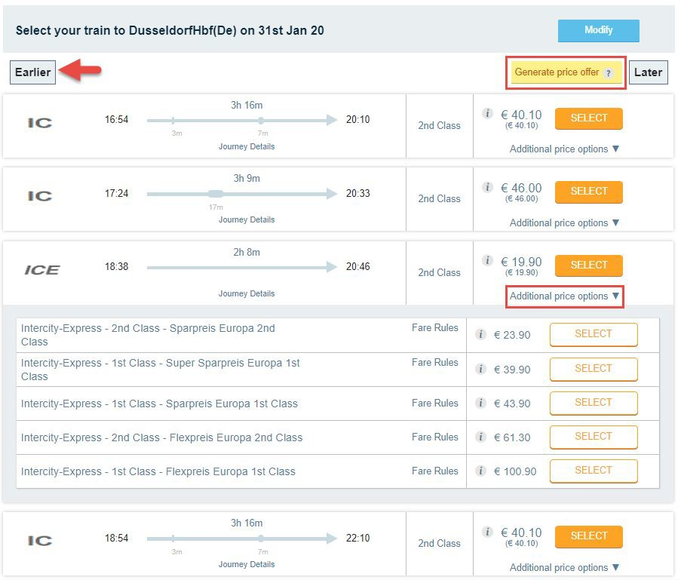
BeNeRail
BeNeRail option can be found on search screen under the ‘EU Rail’ label.
Follow the search and selection process to purchase your tickets
BeNeRail also offers other suppliers’ tickets - such as DeutscheBahn, SNCF, Thalys etc’
Other Products

Slide 49
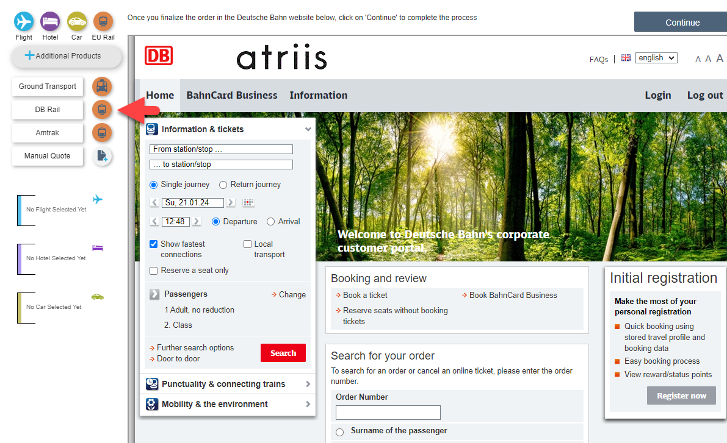
Deutsche Bahn
Deutsche Bahn is available under Additional Products menu when searching for Corporate travelers.
Follow the search and selection process to purchase your tickets.
The booking is made directly on DB website and it’s important to continue with the flow all the way back to Atriis to make sure the PNR/Segment in GDS is created.
Other Products

