Slide 1
Best Practices for agent

Slide 2
Welcome!
Atriis is your one stop shop for all travel products your travelers will need. Book flights, hotels, rail, car rentals and other products from your GDS and directly from the suppliers; manage your online and offline bookings in one system and follow up on your reservations from the trip monitor.
Below you will ﬁnd our best practices and recommendations for taking the best out of the platform and creating fast, efficient and clear workflow.

Slide 3
Available products
GDS content for flights, hotels and car rentals
NDC Flights: LH Group/ BA/ AA/ AF&KL/ UA/ IB
Lowcost - TravelFusion / Ypsilon
Hotel suppliers:
Expedia, Booking.com, RateHawk, Amadeus Hotel Plus, eHotel, Premier Inn, Travelodge
Rail:
Heathrow Express Amtrak
Benerail
DB
Other products: SunnyCars Holiday Extras Groundscope Transferz
Atriis is able to integrate to different GDS and Non-GDS suppliers and have the content available for search, booking and purchase directly from the source. For Non-GDS content we will use passive segments to keep the record and consistent flow with other systems in operation:
General Recommendations

Slide 4
Trip Deﬁnition
Trip is an end-to-end service for a speciﬁc journey of a traveler(s). Our goal is not only to sell the products traveler requested, but also foresee other needs and proactively offer the solutions using our experience and professional skills.
One trip can contain up to 5 travelers and all types of products in multiple quotes. Each trip in the system gets a unique trip number and is only used for the products for the same journey.
General Recommendations

Slide 5
Corporate Context
The platform allows to store and display corporate account information in real time for both online and offline accounts. This means that all agents will have access to speciﬁc corporate negotiated rates for all products, supplier preferences, travel policy information, approval flows, reference ﬁelds and other corporate-related items.
The information will be displayed throughout the booking process and is available in one click before you start working on your trip.
Whichever product you are searching for, simply look for “Related account” ﬁeld and select the corporate account name. We will do the rest!
General Recommendations

Slide 6
Booking Flow

Slide 7
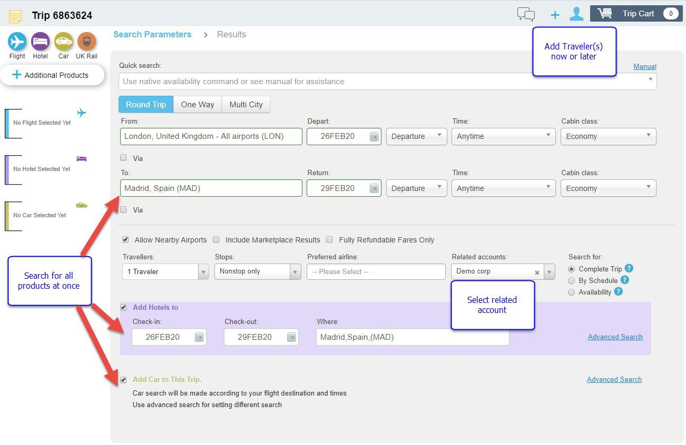
Client’s request and New Trip
Upon receiving a request for travel or information from the client, please start by opening a new trip on the platform. Each trip is unique and should be only used once for the same initial traveler(s).
Once a new trip is open, you can search for flights, hotels and cars all at once, use the corporate context or add traveler(s) to apply the relevant corporate account info.
IMPORTANT: Please note the number of travelers must be speciﬁed before the search
Booking Flow

Slide 8
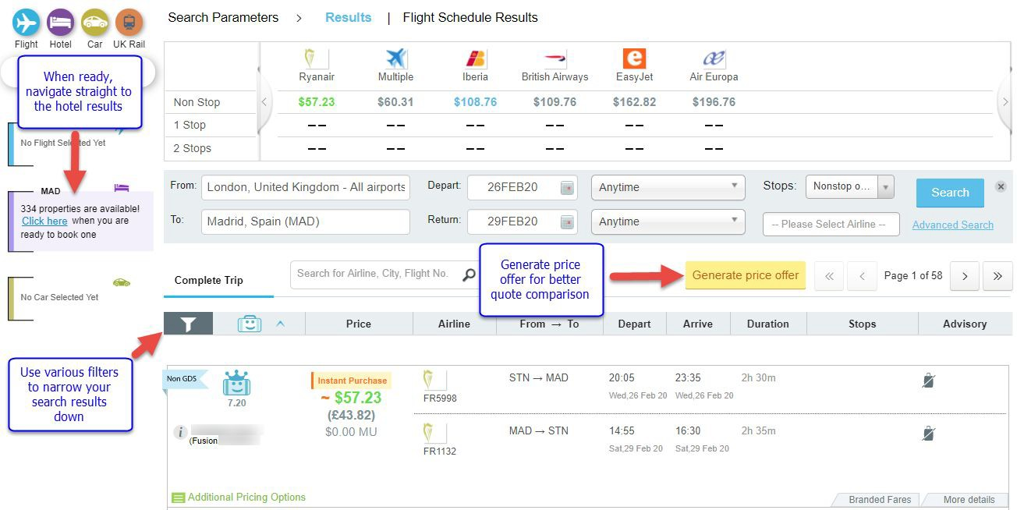
Working with the search results
Flight results from all sources will become available after the search.
You may use different ﬁlters to narrow the list down to precise options that will suit your client’s request.
Corporate information, such as special fares, preferences and travel policy will be applied to the search if corporate account was specified.
When ready, you can navigate straight to the hotel results, without spending more time for additional searches.
Booking Flow

Slide 9
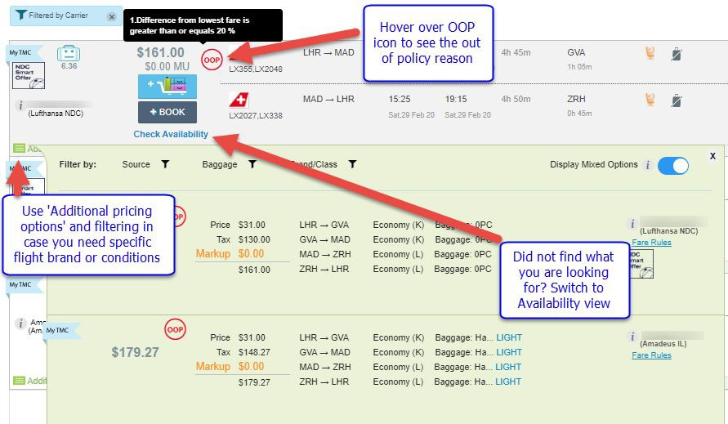
Working with the search results
For each flight result the platform will display the lowest fare at the main result page. However, if a higher price or brand is required, you can always use ‘Additional pricing options’ to book it. Alternatively, ‘Check Availability’ function will display the actual flight availability where you can hand pick your booking class by yourself.
Please note, the flight result page is the main area for working with different pricing options - this will not be available at the later stage in the trip
Booking Flow

Slide 10
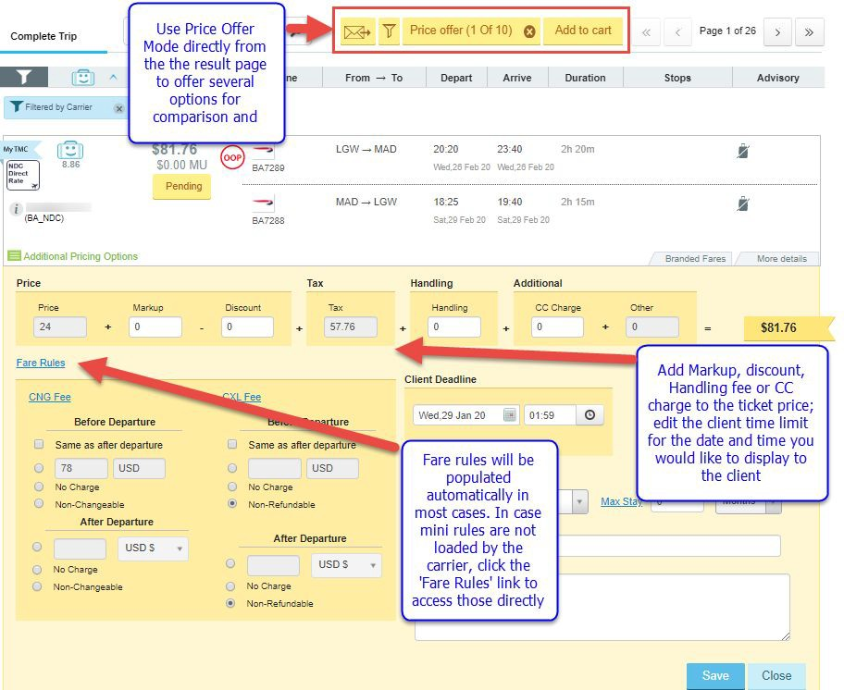
Using price offer in results and trip cart
‘Generate Price Offer’ button will be available on every result page for all products.
You may edit price, time limit and fare rules ﬁelds in a price offer template to amend the way they will be displayed to the client.
If you would like the price offer to include the entire itinerary with all products (flights, hotels, cars, rail), we recommend adding all the relevant options to the trip cart and use the price offer functionality from there.
Booking Flow

Slide 11
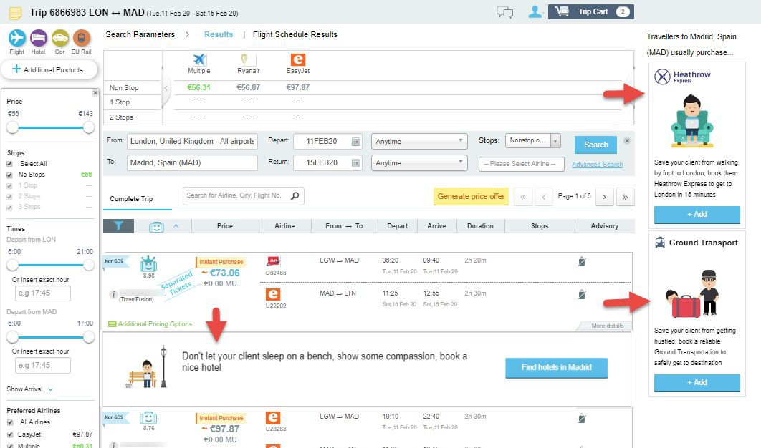
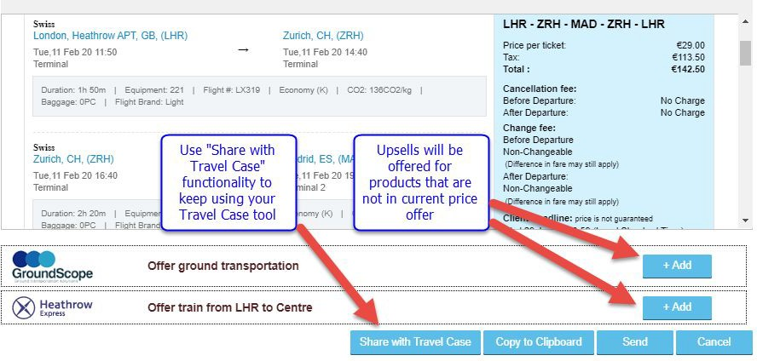
Don’t forget other products!
Upsells for products that are not added to the cart yet will be offered throughout the booking process - you will be reminded that hotels, rail and ground transportation are available for immediate search and booking:
Price offer will also contain an option to add a general offer for client’s awareness of these products.
Booking Flow

Slide 12
Adding meals, seats and optional services
Additional items can be added/purchased separately from the trip cart. For chargeable items the system will create EMD line and pricing in GDS. Please note the offered items might differ between different carriers and sources.
IMPORTANT: not all carriers allow separate baggage purchase. In some cases, price including baggage need to be selected from the result page.
Booking Flow

Slide 13
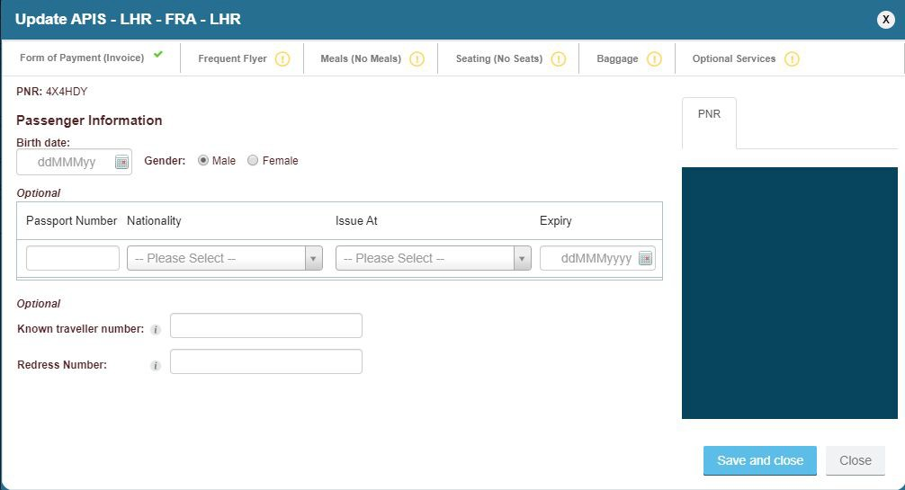
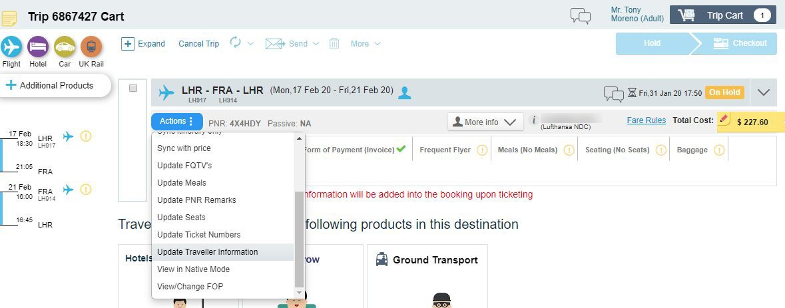
Adding APIS and FQTV information
APIS requirements will be prompted by the platform according to the carrier requirements for a speciﬁc ticket. In case traveler’s proﬁle that contains APIS info was used, the platform will not ask for it again. If no details were present, or only partial APIS info was in a proﬁle, you will be prompted to add missing details in the trip cart:
Booking Flow

Slide 14
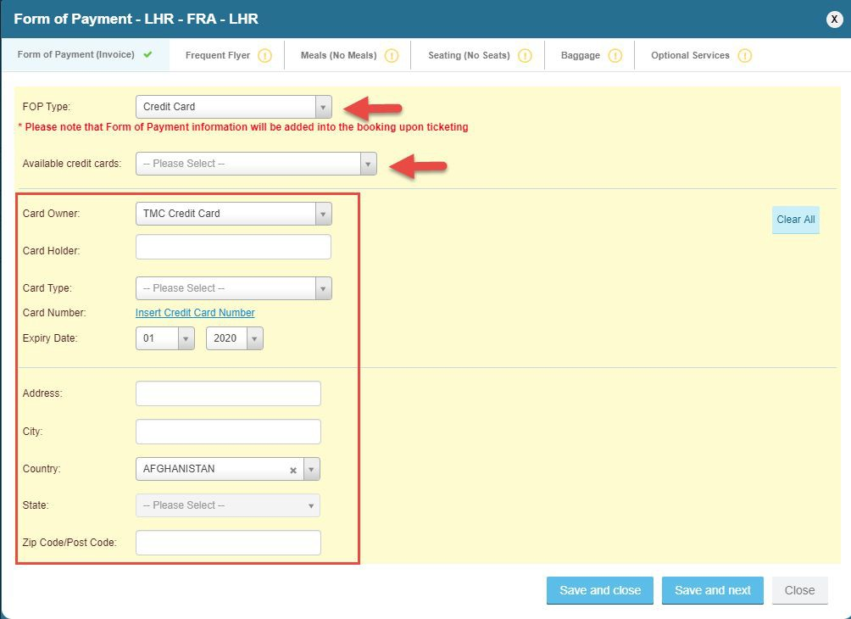
Adding/ changing FOP
Default FOP will be applied according to your TMC and/or Corporate settings.
As an agent, you will always have the option to override and change the original FOP attributed to the trip. You can choose to use Invoice (depending on supplier) or credit card.
Pre-set TMC and Corporate credit cards will be available for selection;
Otherwise, you can add all CC details manually;
IMPORTANT: ability to change FOP is available for agents by default; for online users it is dependent on a specific permission under roles.
Booking Flow

Slide 15
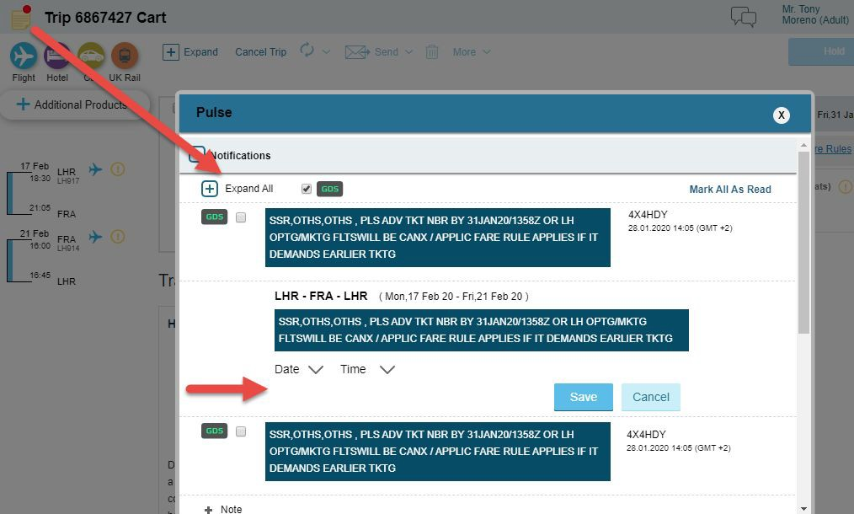
Vendor Remarks
Vendor remarks will appear under the ‘Notepad’ at the top of the left corner in the trip. You can add a reminder for yourself to pop up at certain date and time and display the remark for you
IMPORTANT: please note the system does not automatically update the client time limit based on vendor remark. This action needs to be done manually
Booking Flow

Slide 16
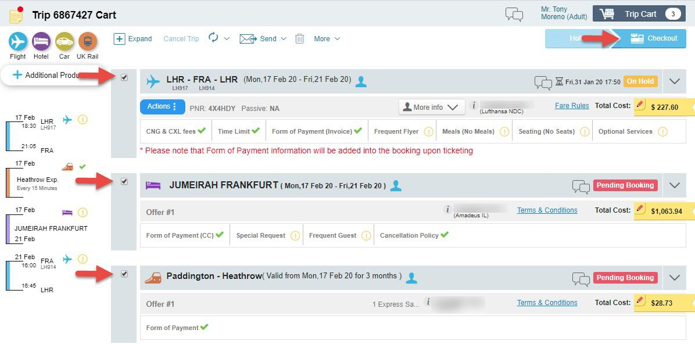
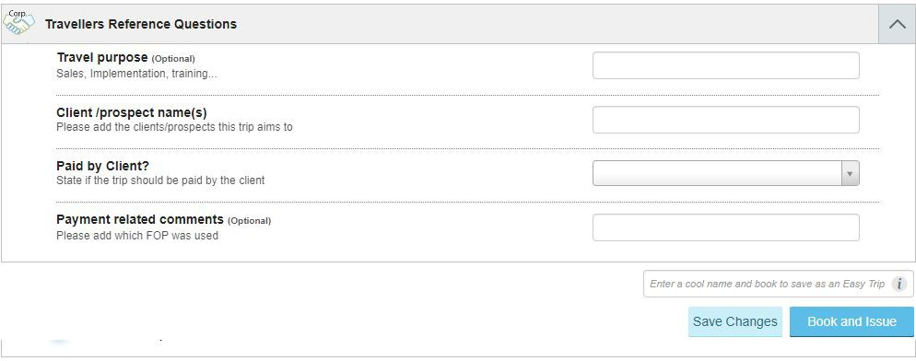
Ticketing and invoicing
When ready to purchase your products, select the quotes and head to checkout.
Checkout process will include all corporate and TMC reference ﬁelds and approval flow (if applied).
In addition, all relevant PNR remarks will be added to the PNR prior to ticketing.
IMPORTANT: all non-GDS content will be issued automatically;
GDS tickets will be issued according to your TMC settings
Booking Flow

Slide 17
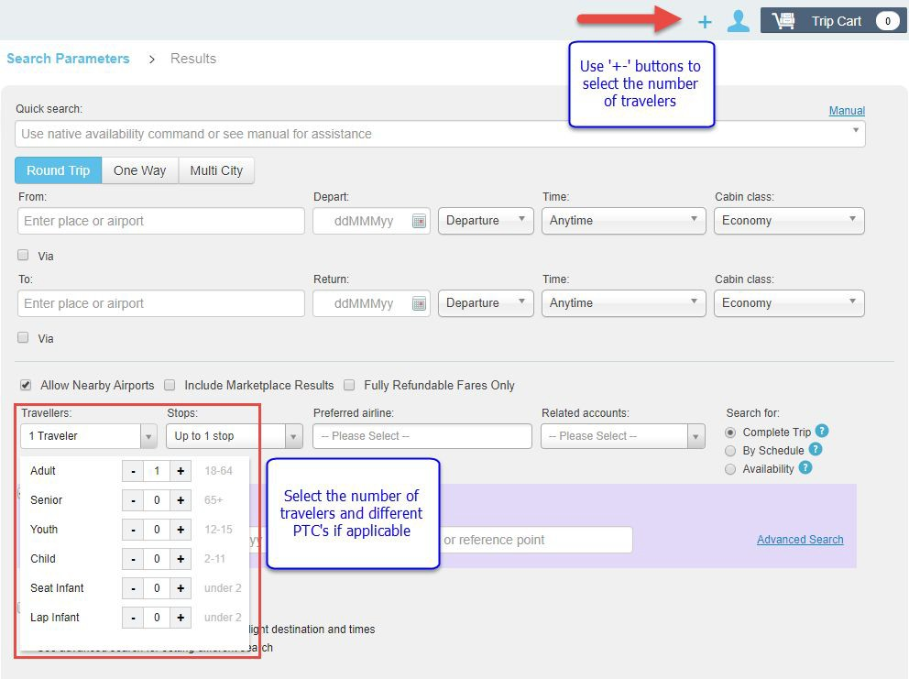
Booking for multiple travelers?
In general, the platform supports bookings for up to 5 travelers in the trip. You can select the number of travelers and add their details using the proﬁle icon at the top of your trip or ‘Travelers’ ﬁeld at the bottom.
However, for corporate travelers we recommend to use one trip per traveler to allow separate FOP, invoicing and possible changes in future.
In case several travelers have the same arrangements, you can use ‘Copy Trip’ functionality to make the process faster.
Booking Flow

Slide 18
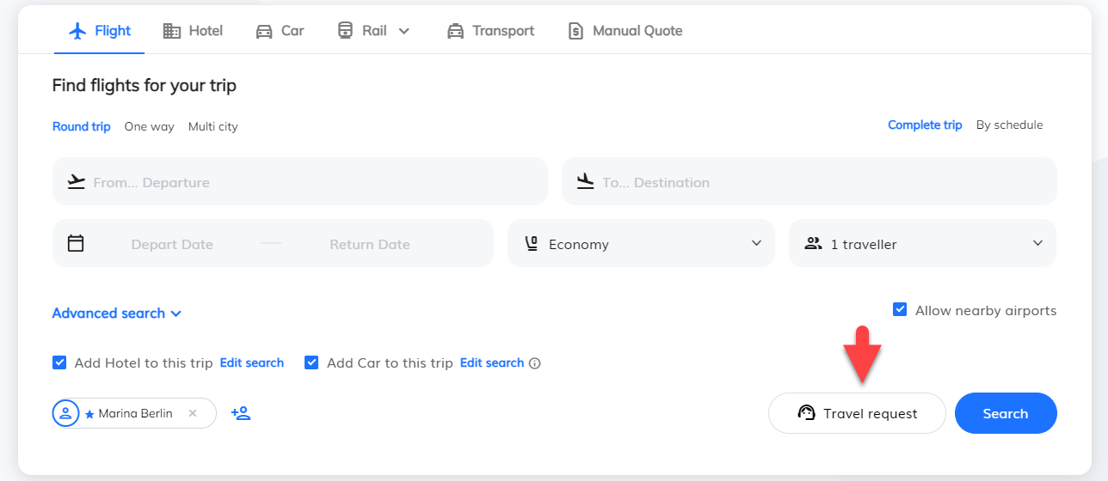
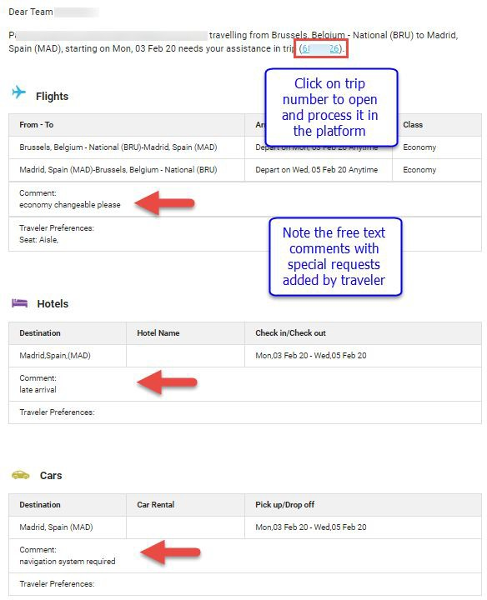
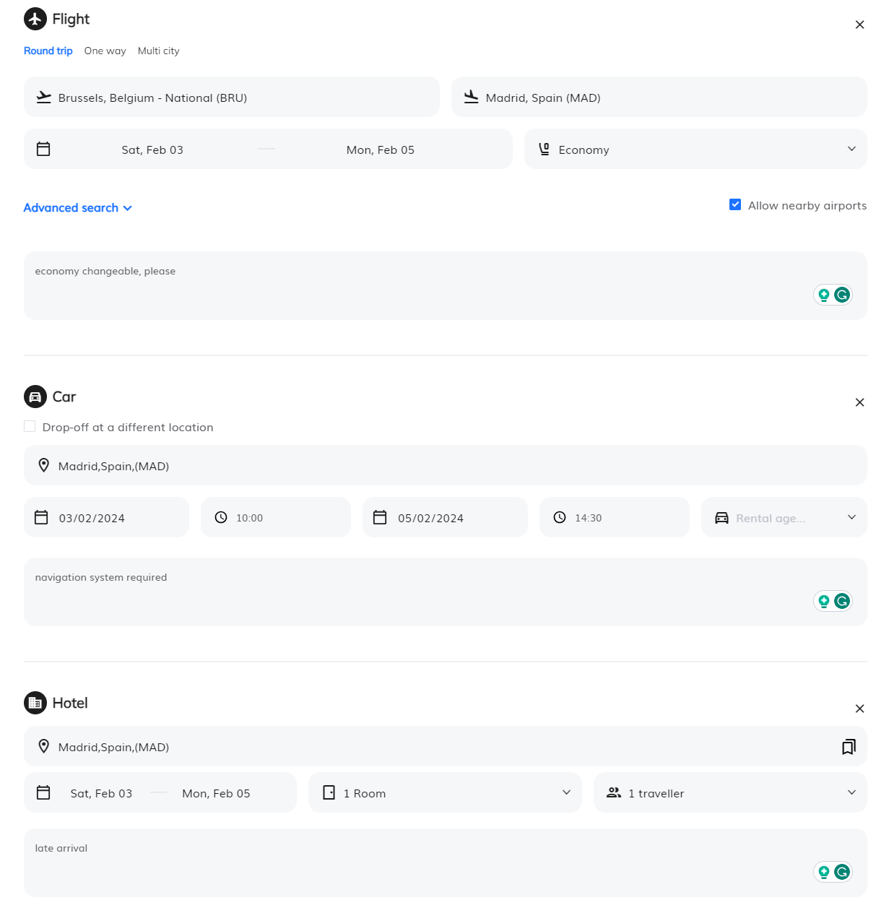
Why online travel request is a great option for agent?
Does your Corporate account have
online access, but prefers to request Traveler’s view: the agent to do the work?
Agent’s view:
Encourage your client to ﬁll the ‘Travel Request’ form and it will make the handling process much more efficient for yourself;
Process the online request either from the platform or open the trip directly from your inbox and simply click ‘Search Online’. The platform will consider all corporate settings and client’s preferences. The only thing you will need to pay attention to, will be the free text comments coming from traveler.
Booking Flow

Slide 19
Post-sale services

Slide 20
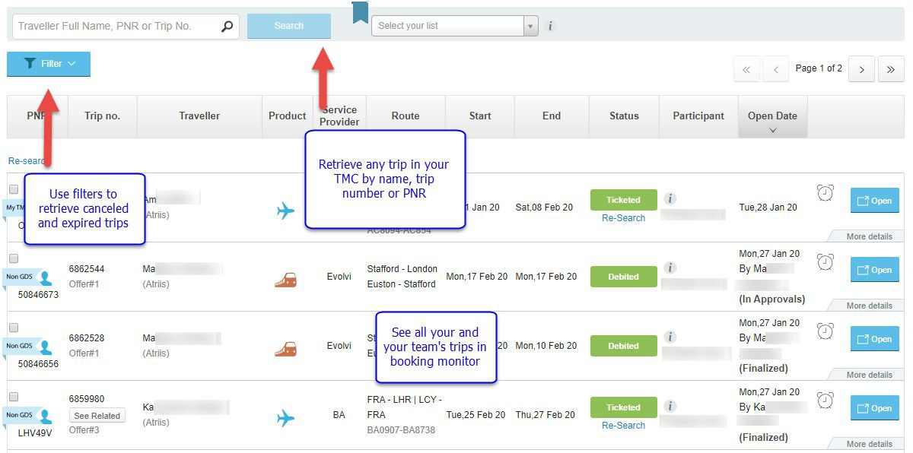
Retrieving an existing trip
Your and your team’s trips will always be available and visible on trip monitor;
You can search for any trip in your TMC by using a search ﬁeld at the top of the screen;
Cancelled and expired trips will be hidden from the booking monitor, but we will keep them in the system. All you need to do is when using the search ﬁeld, open the ﬁlters and tick the checkbox to show cancelled and expired quotes.
Post-sale services

Slide 21
Which changes can be performed on flight bookings?
 | GDS (Amadeus / Travelport) | GDS (Sabre) | BA NDC | LH NDC | UA NDC | AA NDC | AF/KL NDC | IB NDC | TravelFusion
Changes for PNR on hold | ✅ | ✅ | ✅ | ✅ | ✅ | ✅ | ✅ | ✅ | ❌*
Standard exchange for ticketed PNR,upgrade to higher booking class | To be performed directly on GDS and synced back to Atriis trip | ✅ | ✅ | ✅ | ✅ | ✅ | ✅ | ✅ | ❌*
Exchange after departure | To be performed directly on GDS and synced back to Atriis trip | ✅ | ✅ | ✅ | ✅ | ❌ | ✅ | ❌ | ❌*
*The functionality is not supported by the supplier
Post-sale services

Slide 22
Which changes can be performed on flight bookings?
 | GDS (Amadeus / Travelport) | GDS (Sabre) | BA NDC | LH NDC | UA NDC | AA NDC | AF/KL NDC | IB NDC | Travelfusion
More than one exchange | To be performed directly on GDS and synced back to Atriis trip | ✅ | ✅ Up to 3 per ticket | ✅ Up to 3 per ticket | ❌ | ✅ | ✅ | ✅ | ❌*
Change route for ticketed PNR | To be performed directly on GDS and synced back to Atriis trip | ✅ | ✅ | ✅ | ✅ | ❌ | ✅ | ❌ | ❌*
Multi-traveler/ Multi PTC/ Multi-segment | To be performed directly on GDS and synced back to Atriis trip | ❌ Only 1 passenger per trip | ❌ | ✅ PNR needs to be split first | ✅ | ✅ | ❌ | ✅ | ❌*
*The functionality is not supported by the supplier
Post-sale services

Slide 23
How to handle split PNR?
Split PNR action is not supported by the platform as of today
When you need to handle the Split PNR situation, please follow the below process:
Split the PNR in GDS
Import the new PNR into the system
Sync the original trip to update its information
Split functionality is supported for LH NDC and BA NDC bookings. This action will be available in the trip cart in case there is one ticket issued per traveler and the PNR does not contain other products or suppliers.
IMPORTANT: our general recommendation is to use one trip per traveler for the corporate travelers. This is to ensure that each traveler gets the option to use separate FOP, travel policies, approval flow and the flexibility to change the ticket when needed.
Post-sale services

Slide 24
Sync trip with booking source
The platform will sync all the information from GDS every 15 minutes automatically (dependent on the admin settings).
In case a change has been performed and you would like to see in the trip immediately (for sharing the itinerary with the traveler for example), please use one of the following options in the trip cart:
Sync itinerary only - will retrieve and update the segment information
Sync with price - will retrieve and update segment and pricing information
Post-sale services

Slide 25
Cancel | Void | Refund
 | GDS (Amadeus / Travelport) | GDS (Sabre) | BA NDC | LH NDC | UA NDC | AA NDC | AF/KL NDC | IB NDC | Travelfusion
PNR (segment) cancellation for full booking | ✅ | ✅ | ✅ | ✅ | ✅ | ✅ | ✅ | ✅ | ❌*
Partial PNR cancellation | Please cancel the entire quote and re-search for the new itinerary |  |  |  |  |  |  |  | ❌*
Void | To be performed directly on GDS and synced back to Atriis trip | ✅ | ✅ 24 hours after booking | ✅ Auto voided with PNR cancellation before midnight on the day of ticketing |  |  |  |  | ❌*
*The functionality is not supported by the supplier
Post-sale services

Slide 26
Cancel | Void | Refund
 | GDS (Amadeus / Travelport) | GDS (Sabre) | BA NDC | LH NDC | UA NDC | AA NDC | AF/KL NDC | IB NDC | IB NDC | Travelfusion
Refund for unused ticket | To be performed directly on GDS and synced back to Atriis trip |  | ✅ Cancelling the quote will automatically refund cancelled ticket that is not eligible for void |  |  |  |  |  |  | ❌*
Refund for partially used ticket | To be performed directly on GDS and synced back to Atriis trip |  | ❌* | ❌* | ✅ | ❌* | ✅ |  | ✅ | ❌*
Refund after reissue | To be performed directly on GDS and synced back to Atriis trip |  | ❌* | ✅ Cancelling the quote will automatically refund the eligible part of cancelled ticket |  |  |  |  |  | ❌*
*The functionality is not supported by the supplier
Post-sale services

Slide 27
Changes for other products
Products booked directly on GDS (hotels, cars etc’) can be changed directly on GDS and synced back to the trip
Non-GDS suppliers for hotels, car rentals, rail and ground transport do not allow changes to their bookings. In case a change is required, please cancel an existing quote and search for a new one with new search parameters
Post-sale services

Slide 28
Specific Product booking recommendations: FLIGHTS

Slide 29
Flight search methods for best results
Complete Trip | Search by Schedule | Availability
Method: Searching for all city pairs including ﬁnal price (master pricer); | Method: Searching for each city pair individually based on one-way fares, with ﬁnal pricing at the end of process | Method: Searching for and displaying availability in GDS format
When to use: + Long Haul + Round trip/Multi City + Unfamiliar routes Advantages: + Best price & availability overview + Lowest fares compared and displayed clearly for entire route + No extensive experience required to use + Ready for Price Offer + Ready to book immediately Drawbacks: Less results in general (each supplier limits the number of results) Less possible combinations between suppliers, brands, cabins and flight hours Unavailable flights/booking classes are not represented | When to use: + Short Haul + Domestic + Busy Routes + Mixed sources (low-cost, legacy, NDC) + Mixed cabins Advantages: + More options as searches are performed per city pair + Ability to hand pick the perfect combination + Ability to combine segments from different sources (GDS, LCC, NDC) + Ability to combine different cabin classes for each city pair Drawbacks: The ﬁnal pricing is done only at the end of the process No full picture of all options offered for full route More steps to follow Unavailable flights/booking classes are not represented | When to use: + Complex itinerary + Multi city with more than 5 city pairs + Need to offer a variety of options for some/all city pairs + Need to offer speciﬁc booking classes Advantages: + Familiar view + Flexibility in pricing + Add segments as you go + Unavailable flights/booking classes are represented + Ability to work with complex itineraries where pricing and number of tickets might vary depending on carriers and destinations Drawbacks: The ﬁnal pricing is done only at the end of the process Some sources do not support availability view and will be missing from the results No full picture of all options offered for full route More steps to follow Requires knowledge and experience from the user

Slide 30
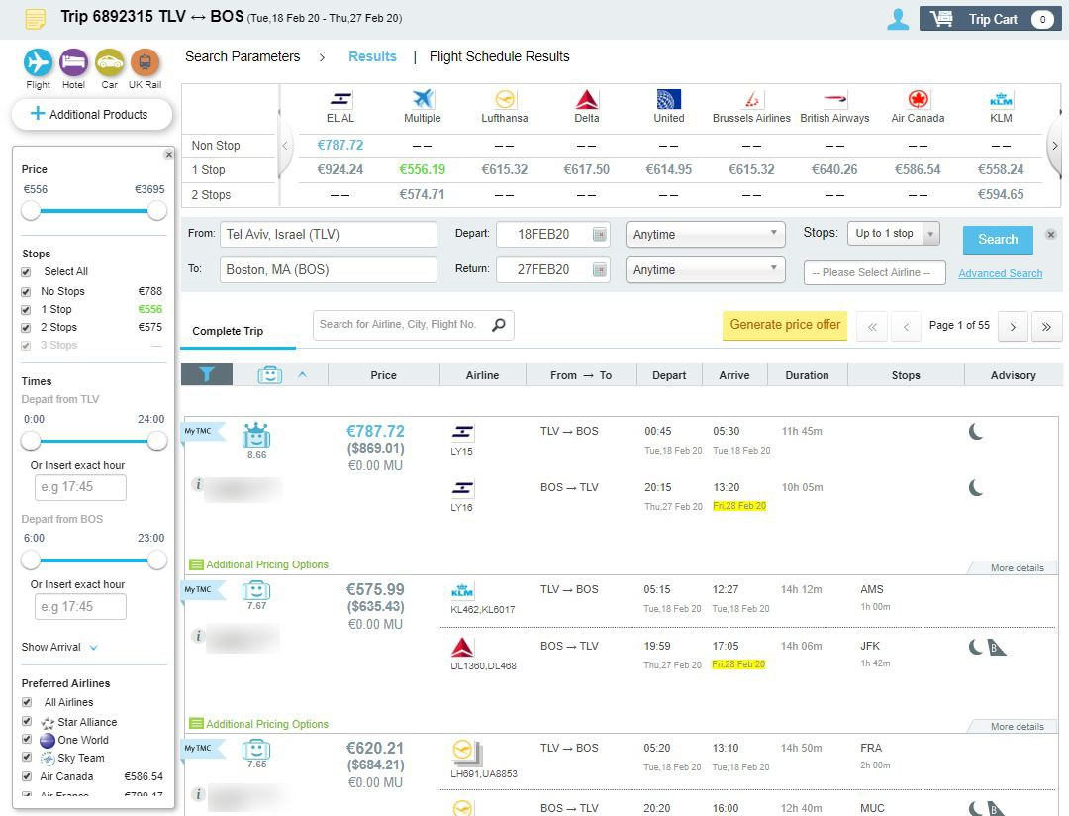
Working with flight results
When working on the platform, please make sure that you select the requested pricing and ticket conditions from the results.
The platform is designed to display:
Negotiated and special rates from TMC and Corporate settings
Different flight brands according to carrier branding
Clear indication of baggage allowance on each result
The variety of offers and combinations from different sources and suppliers
IMPORTANT: due to slight differences in functionality and flow, please note the source of the result before booking
Flights

Slide 31
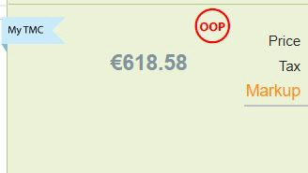
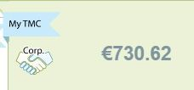
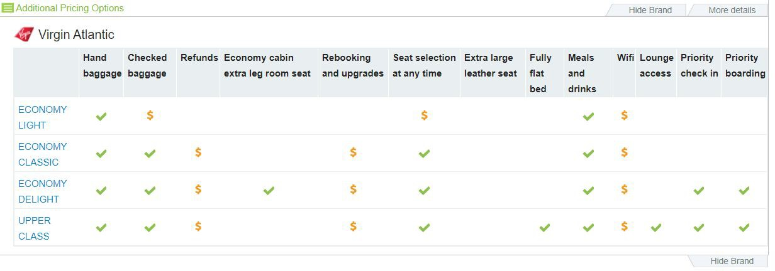
Corporate features
Corporate information is loaded to the system for both online and offline accounts. How does it affect flight booking flow?
Corporate negotiated fares will be displayed
Travel policy rules will be applied and displayed in results, trip cart and checkout process
Corporate preferences in terms of Price/Duration/ Preferred Carriers will be considered and displayed
Carriers, blacklisted by the corporate will not be displayed
Corporate FOP will be applied to the the PNR automatically and may differ between the suppliers
Corporate reference ﬁelds will be requested at the checkout process
Approval flows will apply according to the corporate settings
Flights

Slide 32
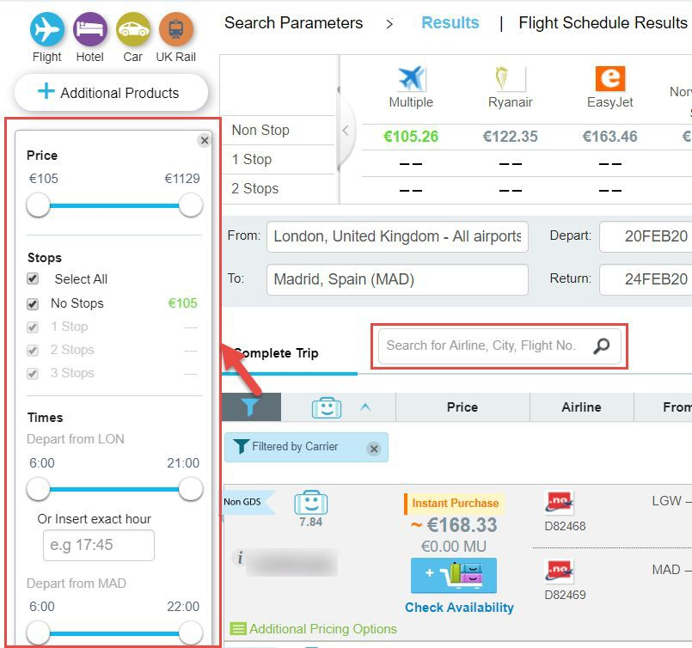
Filtering and sorting
Advanced ﬁltering options will be offered for flight results to allow narrowing the list down to the precise results that match your criteria:
Select multiple speciﬁc carriers, custom time range, duration and price range
Need to search for speciﬁc flight numbers? Use a free text ﬁlter to input the information and we’ll do the rest
Remove any previously applied ﬁlter by clicking on ‘x’ on the blue ﬁlter label at the top of results
Done with the filter pane? Minimize/maximize it by clicking on the funnel icon
Flights

Slide 33
Specific Product booking recommendations: HOTELS

Slide 34
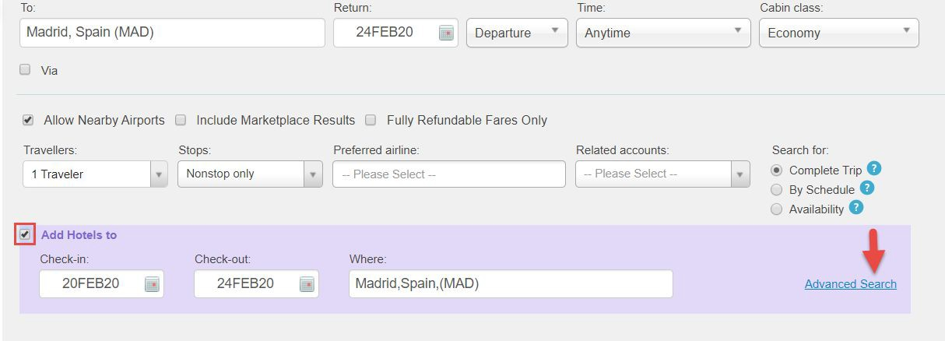
Hotel parallel search
Hotel search can be performed in parallel with flights and the results will be ready before you ﬁnish discussing the seat map with your client! Simply tick the checkbox below the flight search ﬁelds and the system will automatically ﬁll the dates and destination according to the flight parameters:
Hotels

Slide 35
Hotel parallel search
Need to adjust the search criteria for the hotel? Use advanced search mode and search around a speciﬁc address, change the dates or apply chain preference.
*IMPORTANT: room allocation will automatically be 1 room per traveler. If there are 2 travelers in the trip you will be able to select double room as an option. More advanced rooming list options are not currently supported.
Hotels

Slide 36
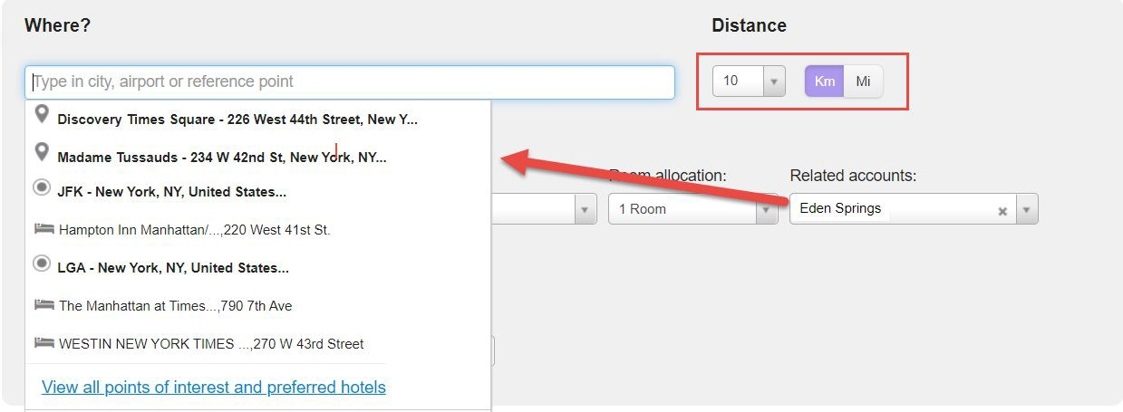
Hotel search by landmark, address or POI
In case a corporate account has been selected, the system will offer a list of saved frequently visited locations (points of interest) for this account and preferred hotels linked to these locations.
Distance can be adjusted to only show the results in close proximity of the reference point.
TIP: you can search for hotels by a speciﬁc name, address or around an official landmark.
Hotels

Slide 37
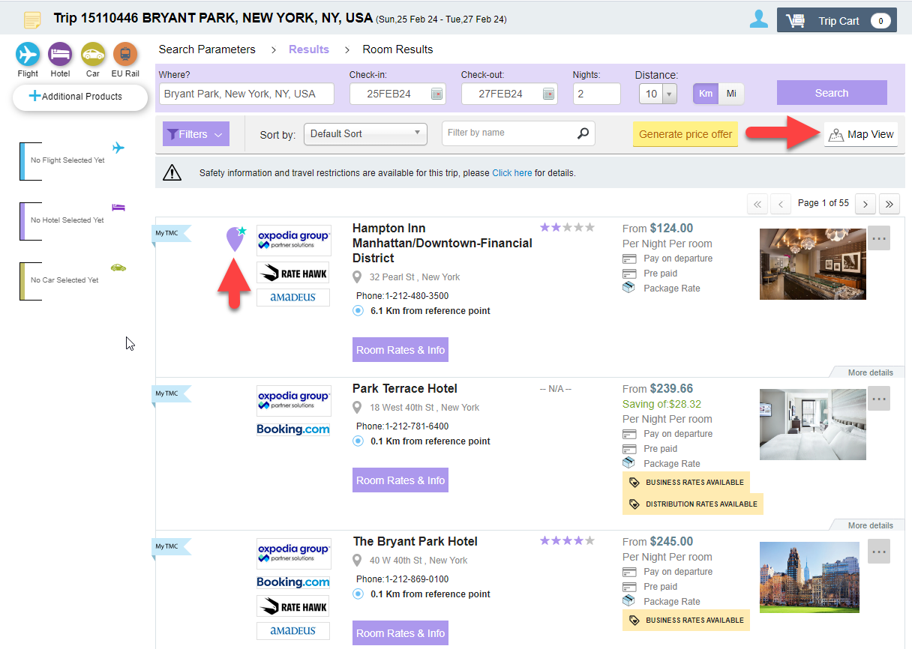
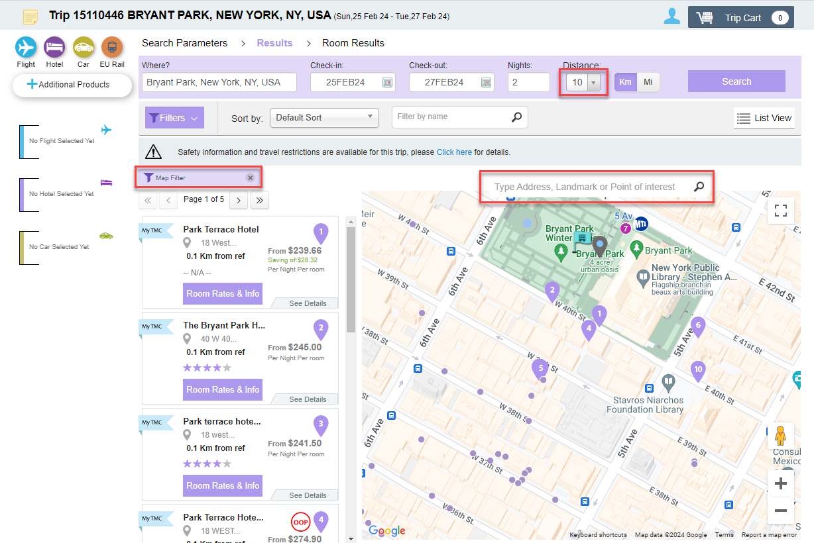
Hotel result display modes
Google Maps are integrated directly into the platform, which means you can:
switch to the map mode to display the results on map
search the map for a speciﬁc address and see all the hotels nearby
display corporate points of interest on the map and see the hotels nearby
see the preferred hotels at their location
Hotels

Slide 38
Specific Product booking recommendations:
CARS & Ground Transport

Slide 39
Car rental: parallel search
After the flight selection, Atriis will automatically apply the flight information as car search parameters. If the drop off time is later than pick up time, it will indicate that additional day of rental will be charged. Dropoff at different location is available by ticking a checkbox and selecting the drop off point.
Car rental

Slide 40
Airport and non-airport search
Searches for non-airport locations are available - please see below the example of the airport and non-airport labels at the location suggestions dropdown.
IMPORTANT: Please note the car delivery option is not available through the platform. Non-airport locations only include the official vendors’ stations.
Car rental

Slide 41
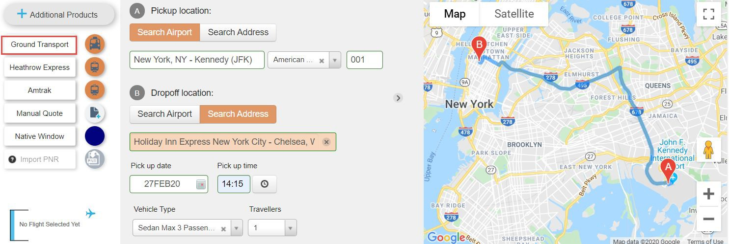
Groundscope | Transferz
If you need to offer a pre-arranged ground transfer, Atriis offers you two global suppliers that can accommodate your travelers. Please make sure the locations for pickup and dropoff contain all the required information to get results. Groundscope and Transferz both work with local transfer companies all over the world and offers flexible booking terms.
TIP: Ground Transportation can be booked as a standalone product
Other Products

Slide 42
Specific Product booking recommendations: RAIL

Slide 43
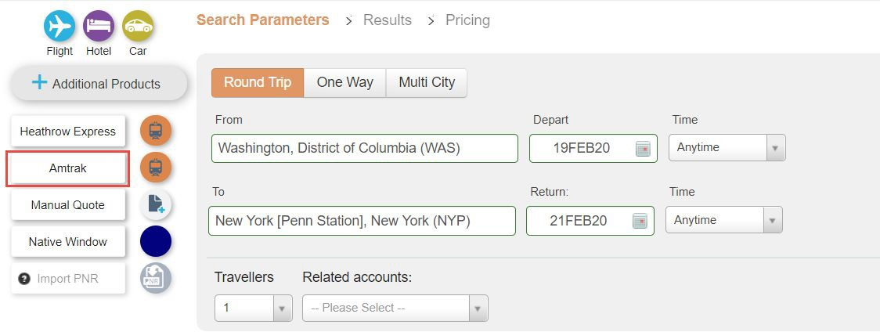
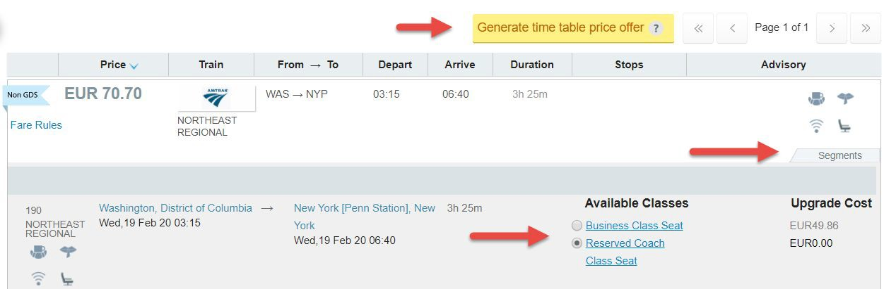
Amtrak
Any travelers in United States? Amtrak rail option is always available for you.
Search, send price offer, and purchase the ticket for your client directly from the platform
Other Products

Slide 44
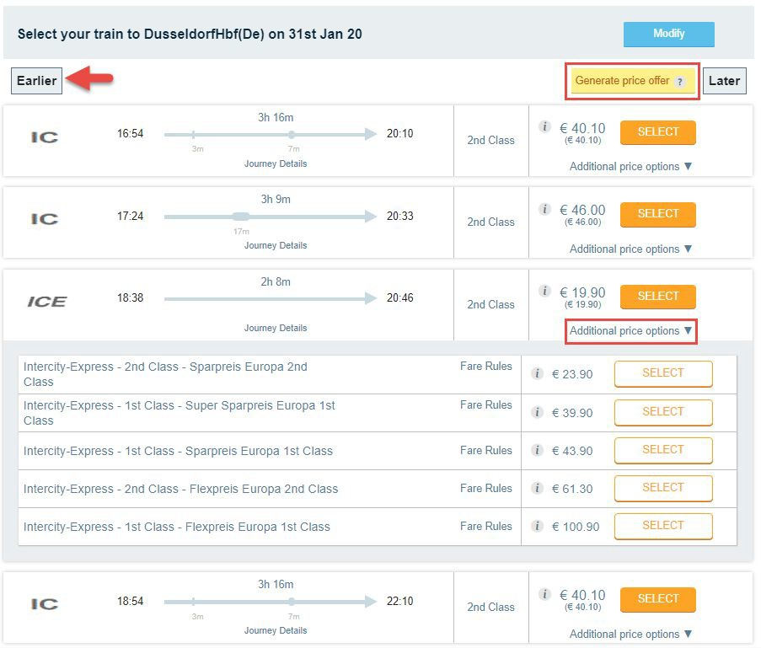
BeNeRail
BeNeRail option can be found on search screen under the ‘EU Rail’ label.
Follow the search and selection process to purchase your tickets
BeNeRail also offers other suppliers’ tickets - such as DeutscheBahn, SNCF, Thalys etc’
Other Products

Slide 45
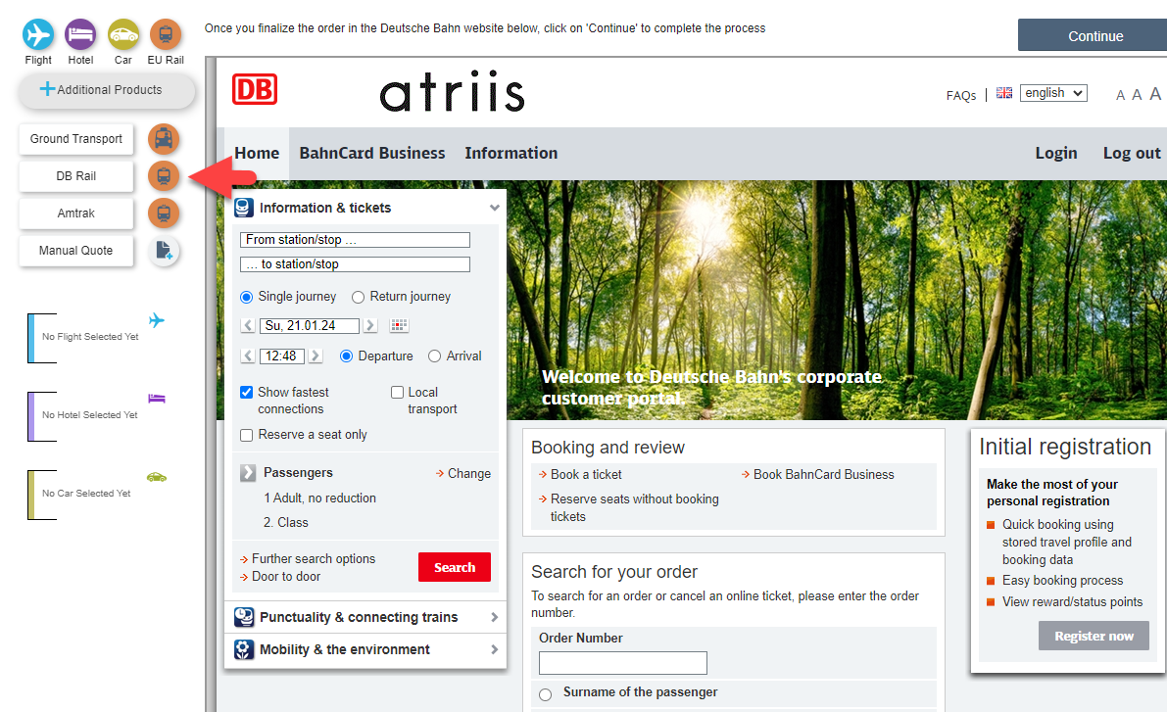
Deutsche Bahn
Deutsche Bahn will be available under Additional Products menu for Corporate travelers.
Follow the search and selection process to purchase your tickets. Please note that the booking is made directly on DB website and it’s important to continue with the flow back to Atriis to make sure the PNR/Segment in GDS is created.
Other Products

